Slide 1
gables:
a roofline model for mobile socs
isaac stier robson
compsci/ece 590
duke university
18 sept 2019

Slide 2
isaac stier robson
roofline
18 september 2019 2 / 28

Slide 3
outline
tl;dr
misc
mobile socs
mathy stuff
paper thoughts
limitations..?
isaac stier robson
roofline
18 september 2019 3 / 28

Slide 4
tl;dr
gables is
a multi-roofline bottleneck analysis tool
specifically for mobile socs
working heavily with IP** accelerators
it incorporates
operations per byte of off-chip (i.e. accelerator) memory traffic
lots of sharing and concurrency stuff
no watts again
** to be addressed later
isaac stier robson
roofline
18 september 2019 4 / 28

Slide 5
misc
isaac stier robson
roofline
18 september 2019 5 / 28

Slide 6
authors
mark d. hill
over 1000 years of academic ancestry
professor at uw-madison cs
vijay janapa reddi
created austin independent school district’s ‘hands-on’ computer science (hacs) program
professor at harvard seas
isaac stier robson
roofline
18 september 2019 6 / 28

Slide 7
mobile socs
isaac stier robson
roofline
18 september 2019 7 / 28

Slide 8
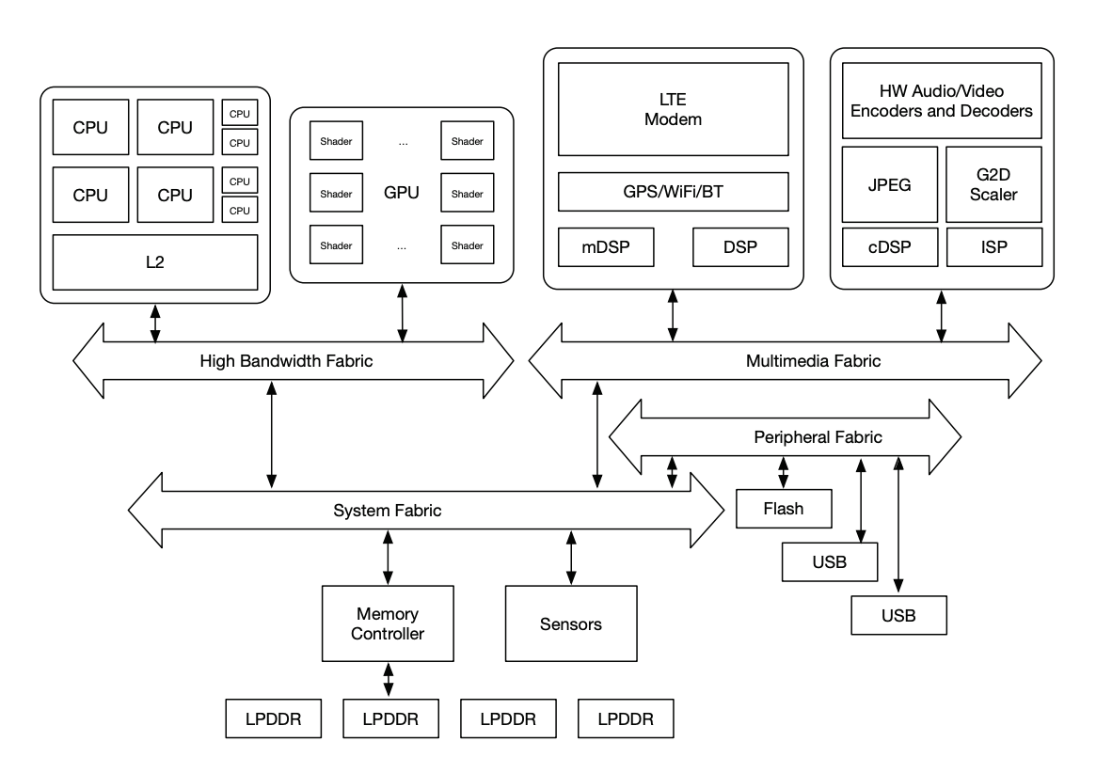
soc diagram
isaac stier robson
roofline
18 september 2019 8 / 28
Notes:
gpu unit likely has a lot of IP blocks

Slide 9
arm big.little
“global [software] task scheduling layer”
big emphasis on “energy efficiency”
- arm developers community
isaac stier robson
roofline
18 september 2019 9 / 28

Slide 10
arm dynamiq big.little
“[combine] the big and little clusters to form a single, fully integrated cpu cluster that consists of both big and little cpus”
“increased single thread performance”
arm developers community
isaac stier robson
roofline
18 september 2019 10 / 28
Notes:
does not appear to be a “dynamic” architecture, just a more tightly coupled asymmetric architecture

Slide 11
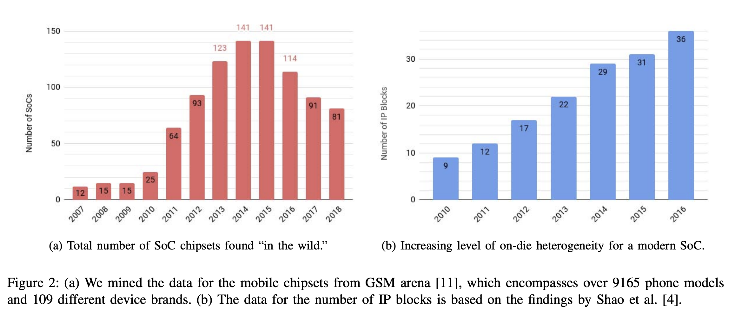
convergence to heterogeneity
simultaneously, lots of increased heterogeneity
many companies dropping out of the mobile soc game…
…possible convergence?
isaac stier robson
roofline
18 september 2019 11 / 28

Slide 12
concurrency
an increasing number of applications rely on multiple cpus and accelerators concurrently functioning
isaac stier robson
roofline
18 september 2019 12 / 28

Slide 13
mathy stuff
isaac stier robson
roofline
18 september 2019 13 / 28

Slide 14
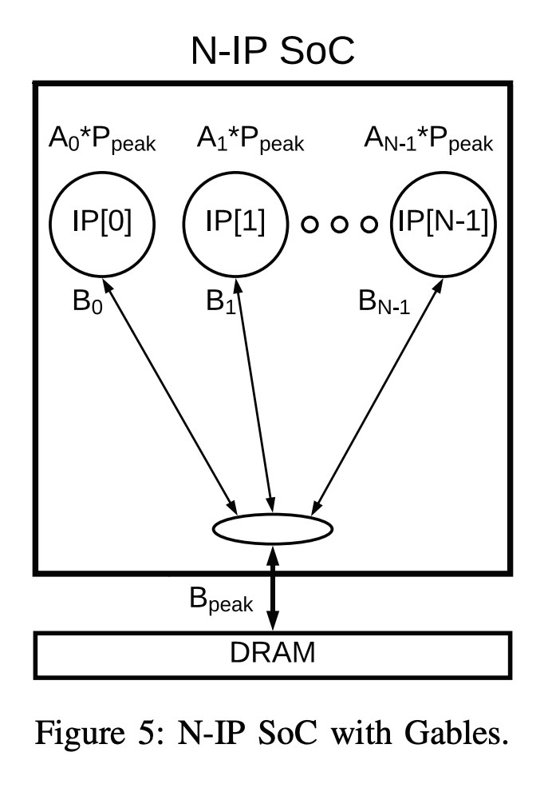
gables
gables: a multi-roofline model
still have peak performance P
and peak bandwidth B_{peak}
but also multiple
individual performances (coefficient times P)
individual bandwidths (B_{i})
for i in 0..n-1 the number of ip blocks
and since lots of accelerators
acceleration factors (A_{i}, the coefficient)
isaac stier robson
roofline
18 september 2019 14 / 28

Slide 15
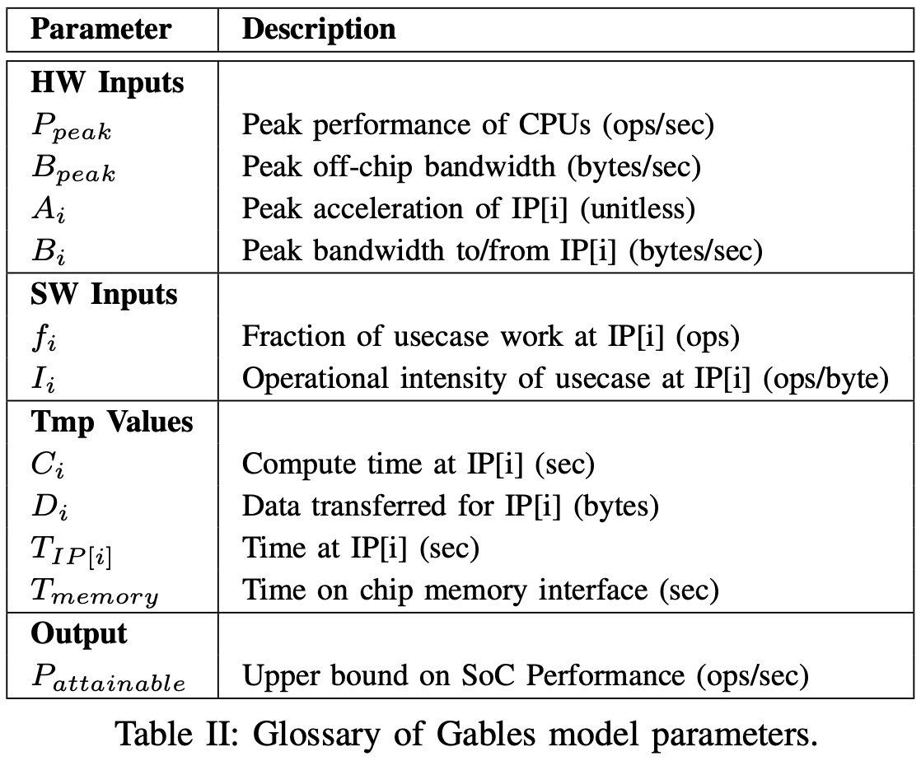
other params
isaac stier robson
roofline
18 september 2019 15 / 28

Slide 16
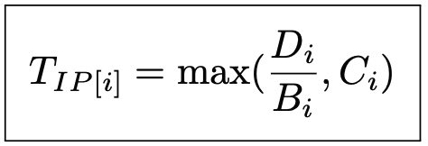
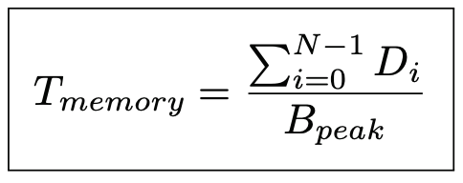
attainable performance
attainable performance is calculated a bit differently
individual data transfer
time spent on any processor
time spent at memory interface
individual bandwidth
individual compute time (next slide)
isaac stier robson
roofline
18 september 2019 16 / 28

Slide 17
attainable performance
this allows us to reformulate the time spent on any processor
fraction of work sent to this IP block
accelerator coefficient times
the peak performance
this looks more like roofline!
= the accelerator performance
individual operational intensity
isaac stier robson
roofline
18 september 2019 17 / 28

Slide 18
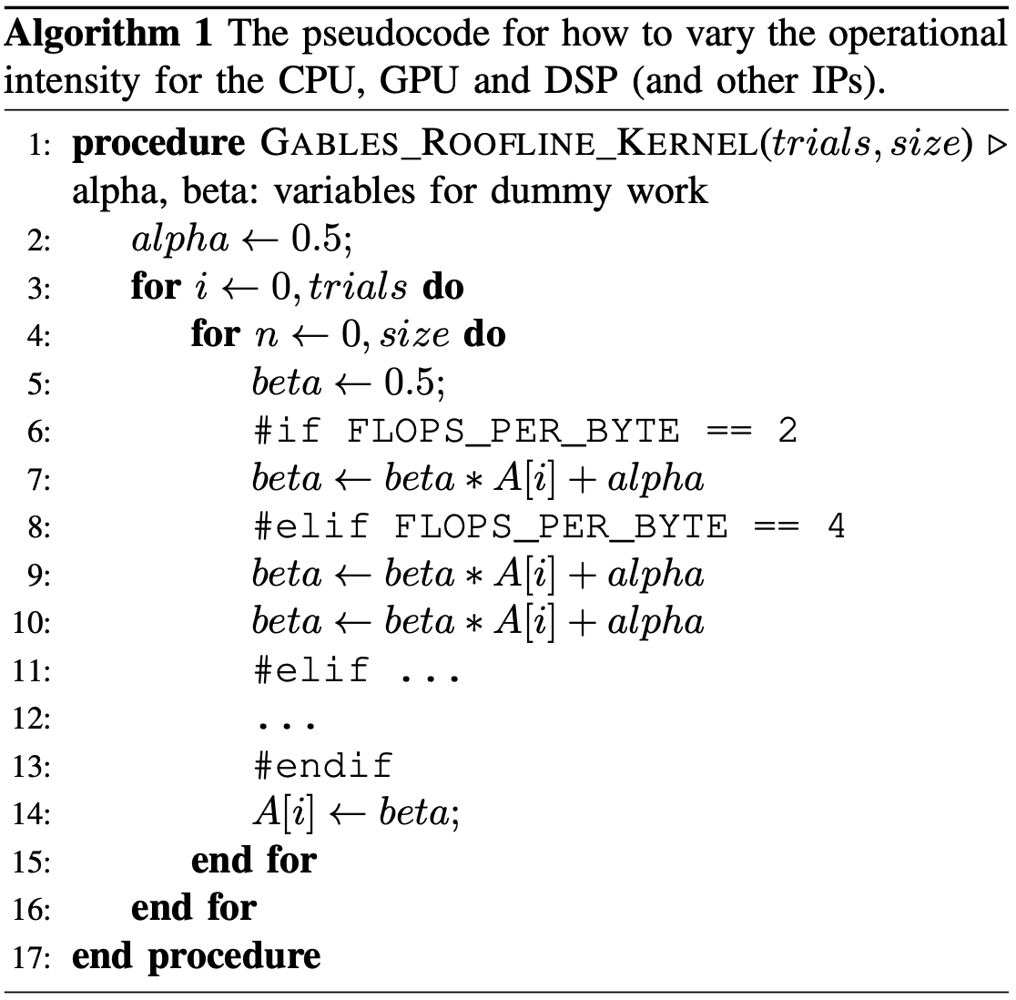
attainable performance
to avoid division by zeros, the authors suggest ignoring any ip block i that has f_{i} = 0
we can also simplify the memory interface wall with the
weighted harmonic mean
of operational intensities
they even gave us some pseudocode to benchmark
isaac stier robson
roofline
18 september 2019 18 / 28

Slide 19
thoughts on paper
isaac stier robson
roofline
18 september 2019 19 / 28

Slide 20
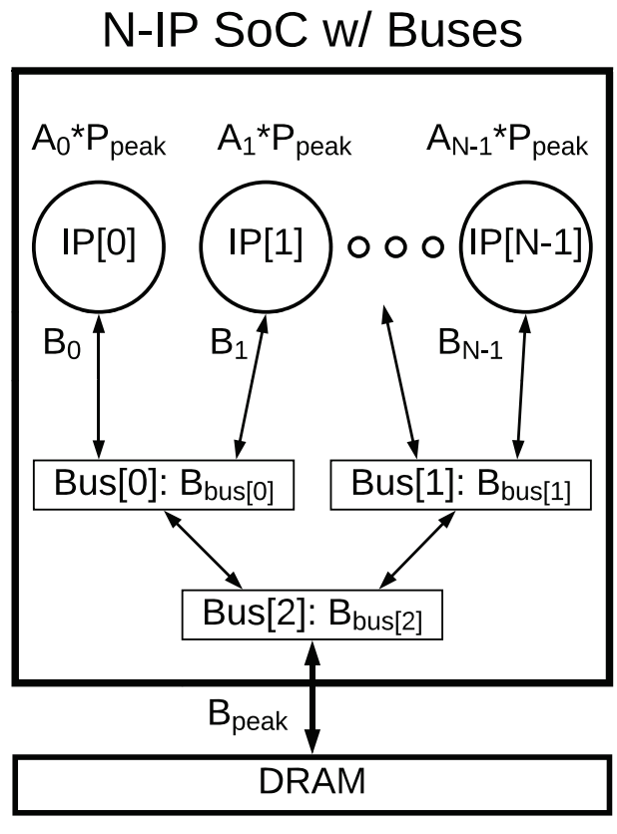
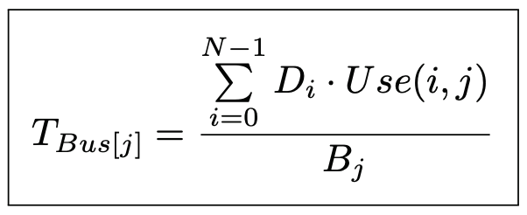
thoughts
overall, a bit more exciting than vanilla roofline
authors did a decent job with a handful of extensions
i,j communication wall
isaac stier robson
roofline
18 september 2019 20 / 28

Slide 21
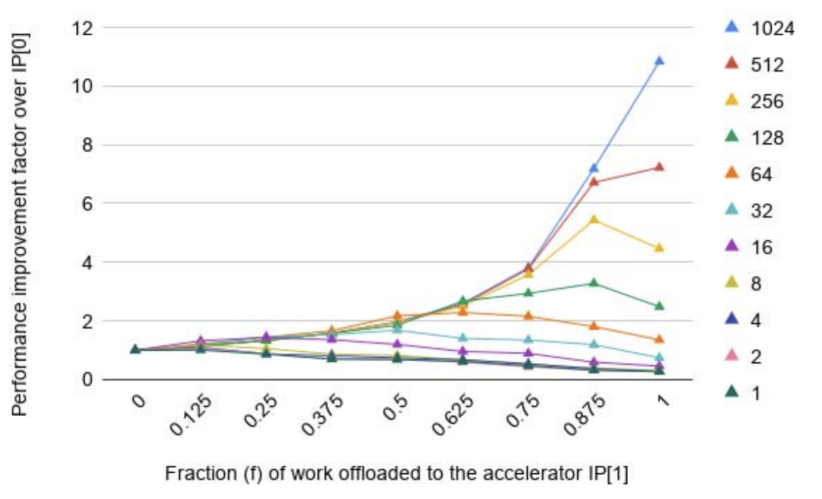
thoughts
they could have done more amdahl modeling…
…but then again it’s a roofline paper
isaac stier robson
roofline
18 september 2019 21 / 28

Slide 22
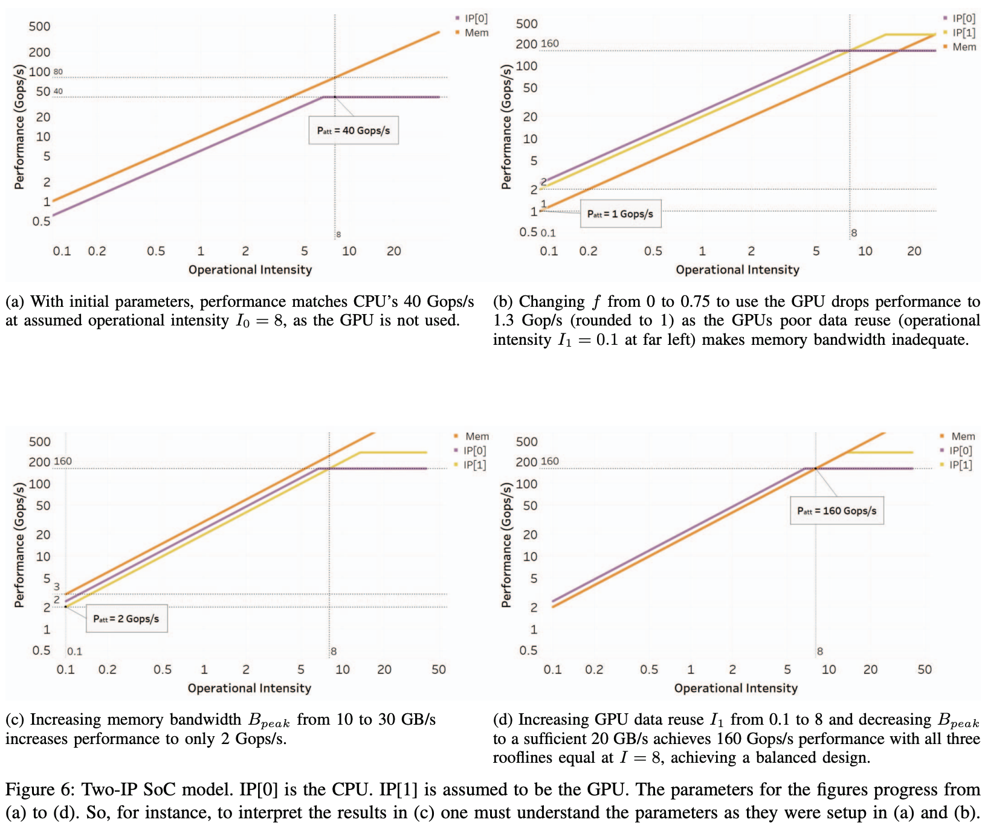
thoughts
they definitely should have done more of this tho…
…an actual example of this would have been beneficial
isaac stier robson
roofline
18 september 2019 22 / 28

Slide 23
limitations..?
isaac stier robson
roofline
18 september 2019 23 / 28

Slide 24
is this really that huge for mobile computing?
quite likely we’ll see laptops adopting heterogenous architectures, but…
…i was under the impression the pillars of mobile computing were:
mobility
energy efficiency
network latency
network bandwidth
and roofline… doesn’t consider either energy or network properties
isaac stier robson
roofline
18 september 2019 24 / 28

Slide 25
weird tangents vaguely related to limitations
isaac stier robson
roofline
18 september 2019 25 / 28

Slide 26
the fog
isaac stier robson
roofline
18 september 2019 26 / 28

Slide 27
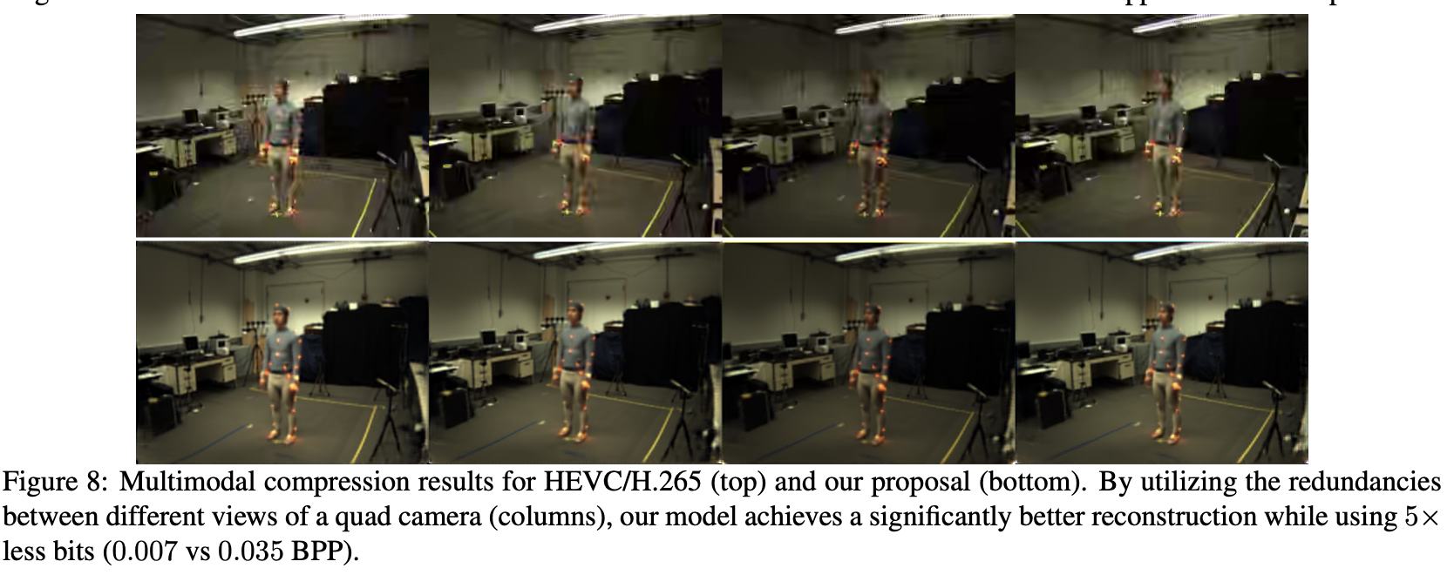
5g + asymmetric neural video compressors?*
*meaningless buzzwords i chained together
isaac stier robson
roofline
18 september 2019 27 / 28

Slide 28
fin
isaac stier robson
roofline
18 september 2019 28 / 28

