Slide 1
roofline:
an insightful visual performance model for floating-point programs
and multicore architectures
isaac stier robson
compsci/ece 590
duke university
18 sept 2019

Slide 2
moi
grad student in stats
i use accelerators for machine learning
currently do research in biomedical engineering (proteins)
background in math and finance et al.
fun fact: quite allergic to cats
isaac stier robson
roofline
18 september 2019 2 / 33

Slide 3
outline
tl;dr
misc
examples
mathy stuff
uses/extensions
thoughts on paper (time permitting)
isaac stier robson
roofline
18 september 2019 3 / 33

Slide 4
tl;dr
roofline is
a bottleneck analysis tool
for high throughput multicore** machines
used via simple visual inspection
it incorporates
operations per byte of main memory traffic
not per byte of cache traffic
nor per watt or per second
** to be addressed later
isaac stier robson
roofline
18 september 2019 4 / 33

Slide 5
misc
isaac stier robson
roofline
18 september 2019 5 / 33

Slide 6
own wiki page???
“roofline is used to describe the fascia, soffits, bargeboards, antefixes and cladding that forms the frontage immediately below the roof and the eaves of many homes and buildings…”
- wikipedia.org
isaac stier robson
roofline
18 september 2019 6 / 33

Slide 7
but ya own wiki page
its kind of a big dealio…
isaac stier robson
roofline
18 september 2019 7 / 33

Slide 8
authors
samuel williams (now a parallel researcher at lbnl)
andrew waterman (now chief engineer at sifive, semiconductor company with > $100m valuation)
david patterson (yes, of hennessy and patterson… …the ones with the turing award)
isaac stier robson
roofline
18 september 2019 8 / 33

Slide 9
examples
isaac stier robson
roofline
18 september 2019 9 / 33

Slide 10
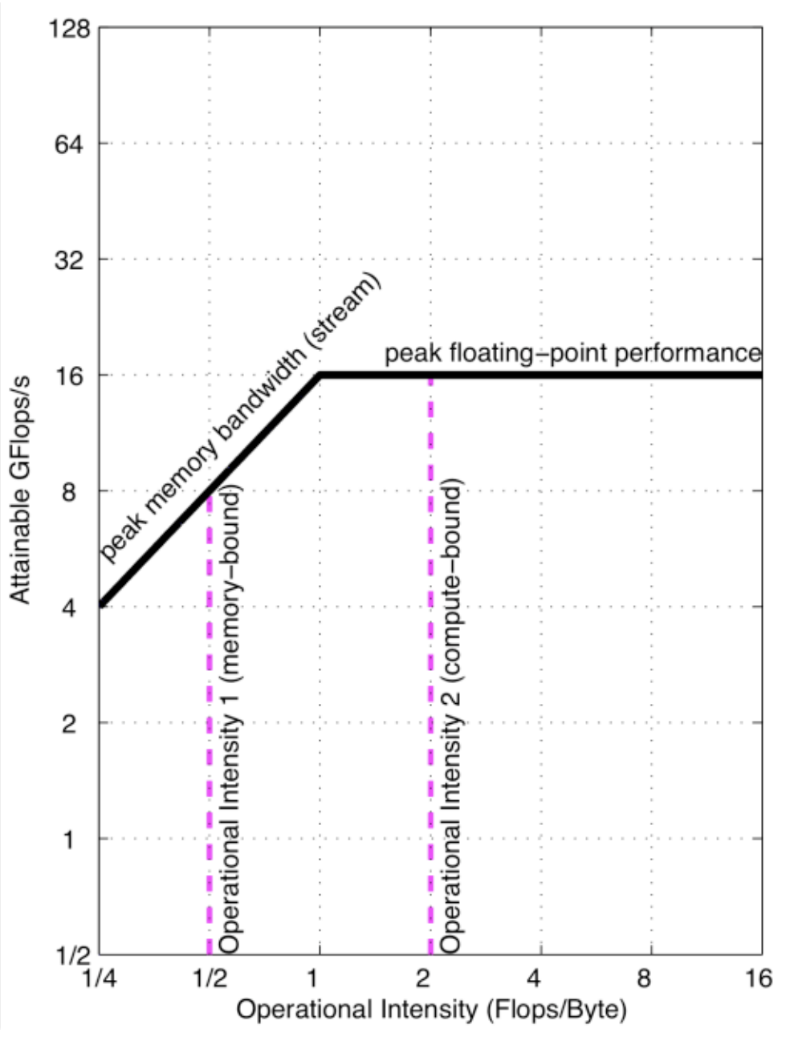
example 1
isaac stier robson
roofline
18 september 2019 10 / 33

Slide 11
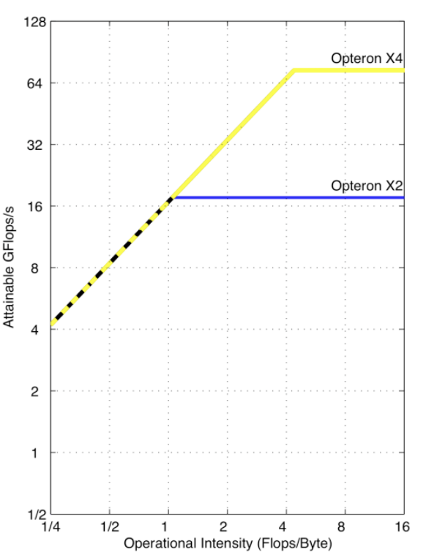
example 2
four cores
x4 has:
2x # cores
2x floating-point per core
prefetching/ghz buffs
=> 4x higher ceiling
different ”ridge point”
min # flops/byte at ceiling
here 4x as no change in memory bandwidth
4x ceiling
two cores
same memory bandwidth
note:
we are discussing machines
we only fit roofline once per machine!
4x ridge
point
isaac stier robson
roofline
18 september 2019 11 / 33

Slide 12
mathy stuff
isaac stier robson
roofline
18 september 2019 12 / 33

Slide 13
attainable performance
$$A= \min_{}\left\{\begin{aligned}π \\ β × I\end{aligned}\right.$$
$A$, attainable performance (ops/sec)*
$π$, peak performance (ops/sec)*
$β$, peak bandwidth (bytes/sec)
$I$, operational intensity (ops/byte)*
*usually floating-point ops
isaac stier robson
roofline
18 september 2019 13 / 33

Slide 14
operational intensity
analog (flux):
$$flux = \frac{Current}{Area}$$
in case u forgot ;)
if $β ↔ Area$
$$→A↔Current$$
$$I=\frac{O}{M}$$
$I$, operational intensity (ops/byte)*
$O$, operations (ops)*
$M$, main memory access (bytes)
isaac stier robson
roofline
18 september 2019 14 / 33

Slide 15
“the ceiling is the roof”
except in roofline…
…there are multiple ceilings
isaac stier robson
roofline
18 september 2019 15 / 33

Slide 16
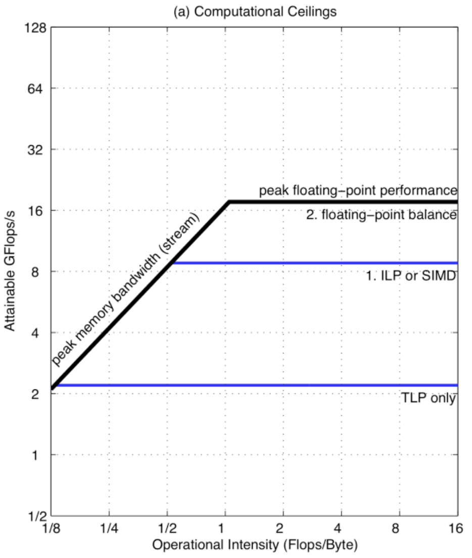
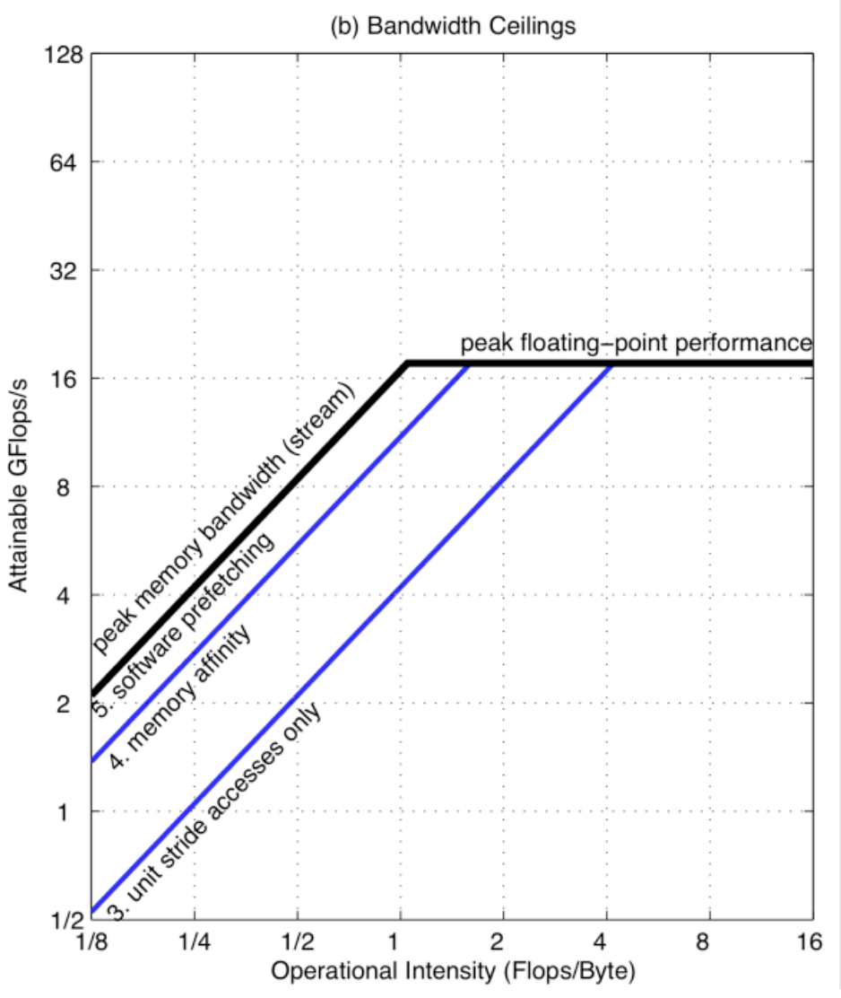
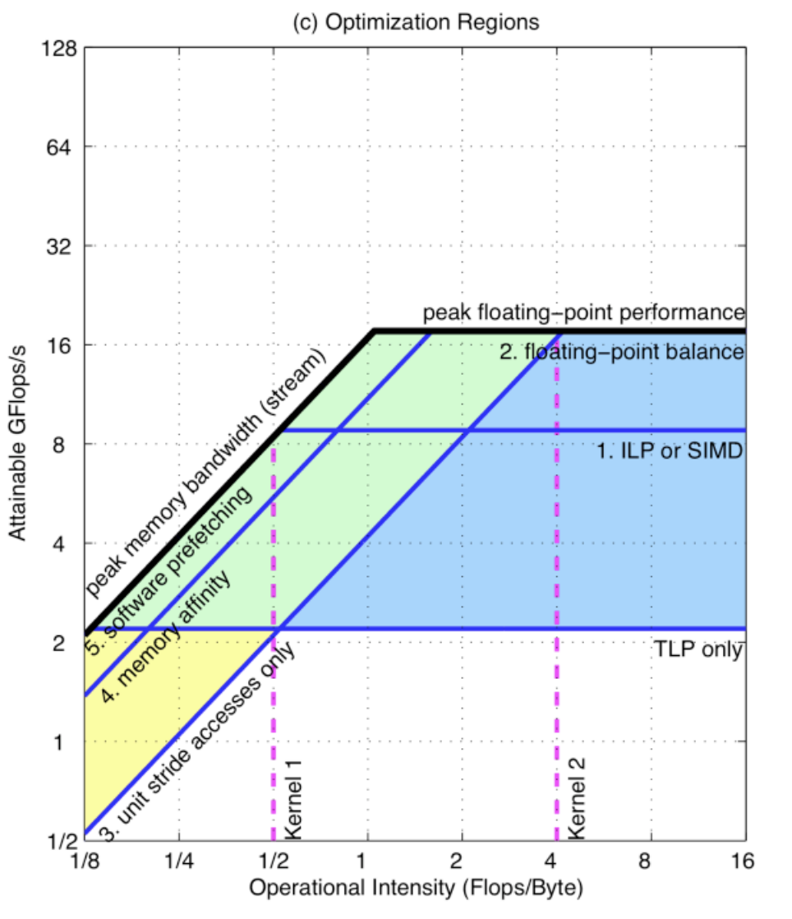
“the ceiling is the roof”
isaac stier robson
roofline
18 september 2019 16 / 33

Slide 17
uses/extensions
isaac stier robson
roofline
18 september 2019 17 / 33

Slide 18
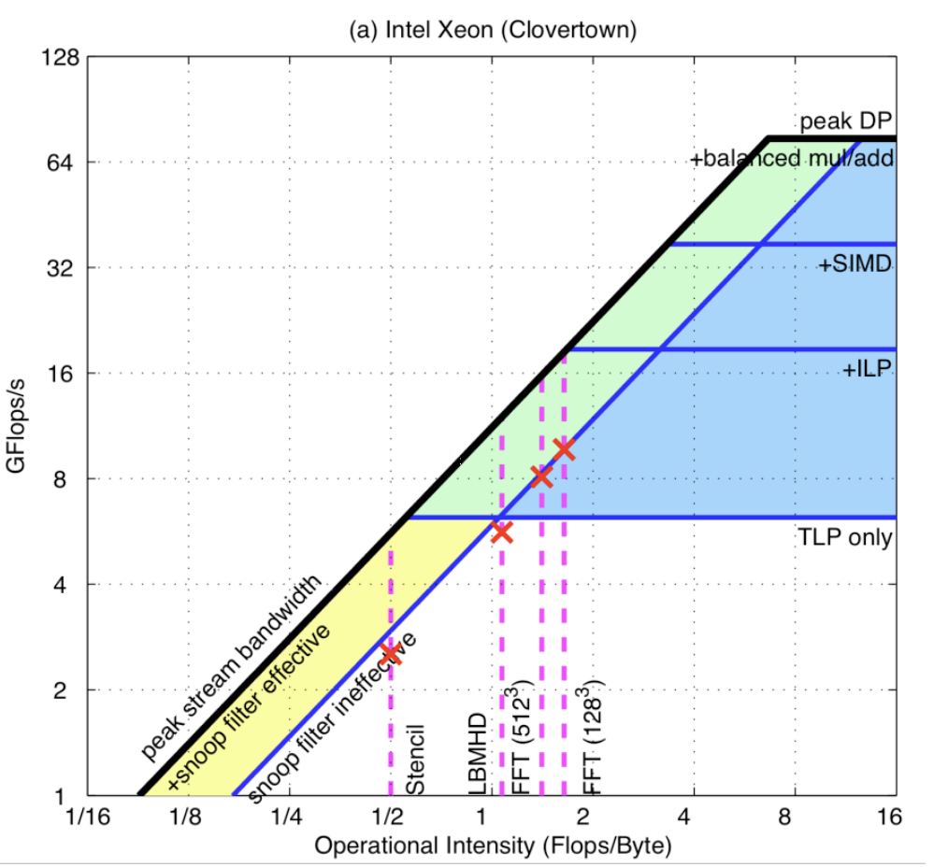
identifying what u missed
isaac stier robson
roofline
18 september 2019 18 / 33

Slide 19
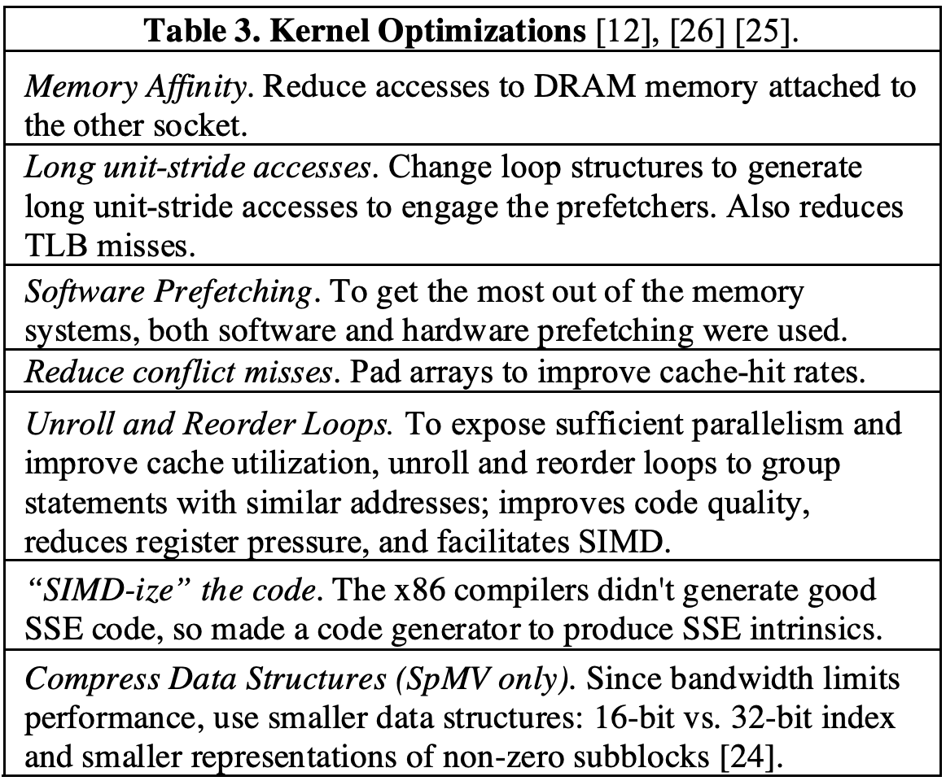
helpful things to do
isaac stier robson
roofline
18 september 2019 19 / 33

Slide 20
very realistic use case: cat detector
step 1: cat
step 2: neural net
step 3: picking a gpu [ insert roofline here ]
isaac stier robson
roofline
18 september 2019 20 / 33

Slide 21
cat detector: cost to train
amd purrx
$1.50 / hour on paws
say a similar net trained at 2.0 operational intensity…
…we could get 2x the performance by upgrading
while we save time, we would spend 50% more
nvidia tailsla
$0.50 / hour on paws
cattainable gflops/s
operational intensity (feline ops/bite)
isaac stier robson
roofline
18 september 2019 21 / 33

Slide 22
cat detector: cost to train
amd purrx
$1.50 / hour on paws
at 8.0 operational intensity…
…we might achieve a 4x training speed…
…at a 25% reduction in cost
which saves time and money
nvidia tailsla
$0.50 / hour on paws
cattainable gflops/s
operational intensity (feline ops/bite)
isaac stier robson
roofline
18 september 2019 22 / 33

Slide 23
but isaac isn’t roofline for multicore?
as ximing pointed out on monday, roofline ignores latency
while for tightly coupled machines, this might be forgivable in well-pipelined scientific computing…
wouldn’t the host/device latency invalidate roofline?
many ml frameworks just use cpus to pipeline data into the accelerator
welllll
soooooo
…
isaac stier robson
roofline
18 september 2019 23 / 33

Slide 24
but isaac shouldn’t u optimize ur kernels first?
welllll
soooooo
…
keras
….small tangent
tensorflow
python
cudnn
eigen
blas
c++
cuda
gpu
isaac stier robson
roofline
18 september 2019 24 / 33

Slide 25
jeff dean
“jeff dean compiles and runs his code before submitting, but only to check for compiler and cpu bugs.” - quora
isaac stier robson
roofline
18 september 2019 25 / 33

Slide 26
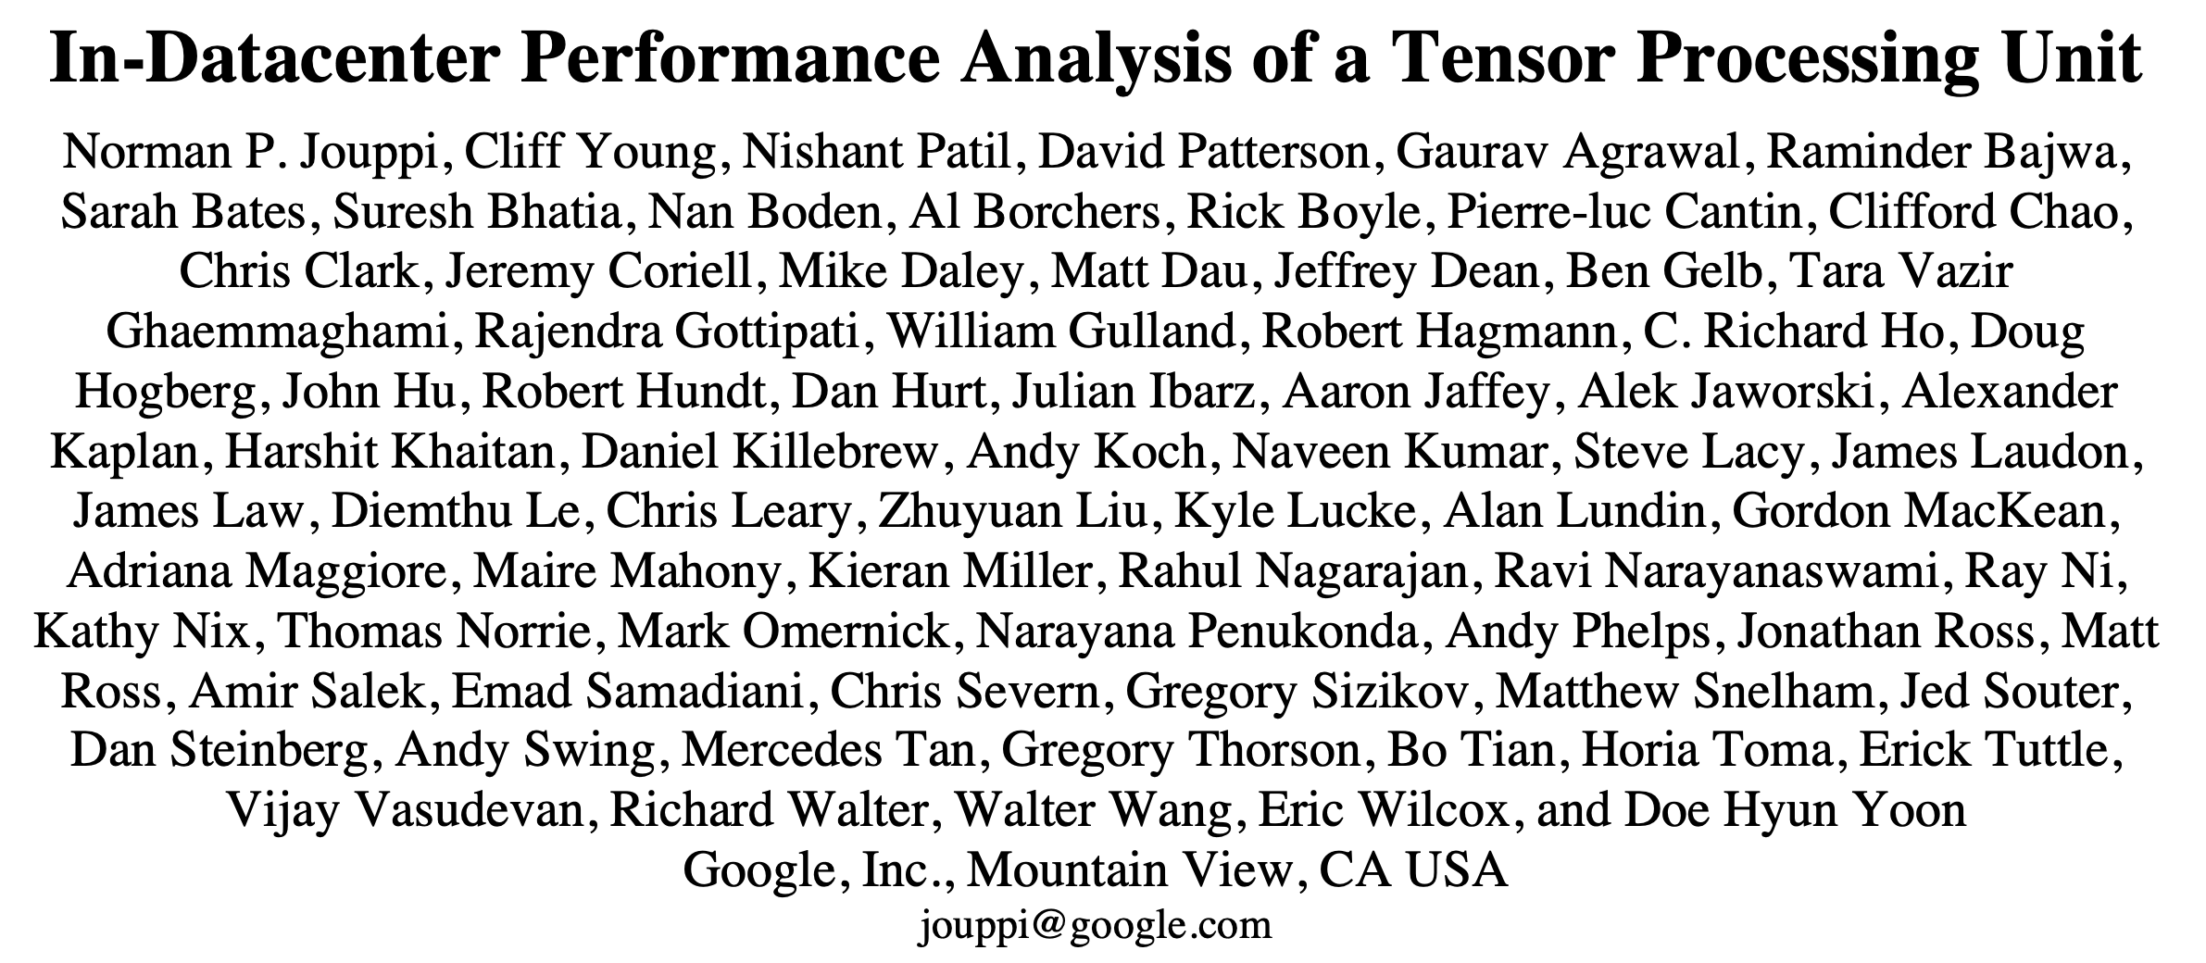
don’t take my word for it
isaac stier robson
roofline
18 september 2019 26 / 33
Notes:
take the word of these 76 people!

Slide 27
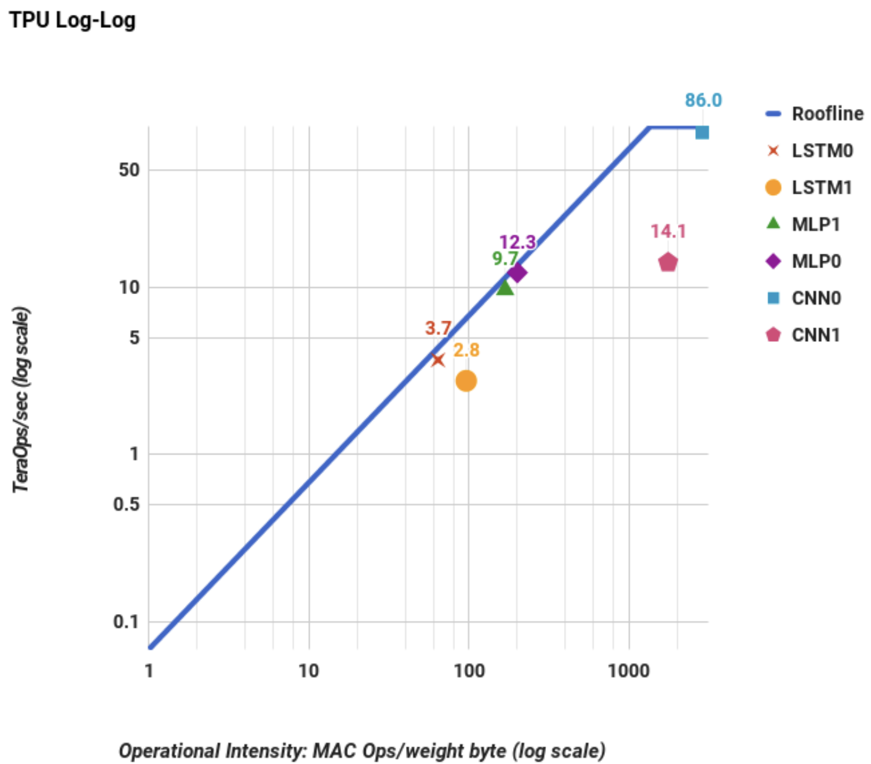
roofline extension: tpu
isaac stier robson
roofline
18 september 2019 27 / 33

Slide 28
roofline-inator 3000
tpus don’t always use floating point ops…
they frequently used quantized real numbers in 8-bit integer format
so the authors replaced flops with intops
but also… per weight byte?
isaac stier robson
roofline
18 september 2019 28 / 33

Slide 29
roofline extension: tpu
isaac stier robson
roofline
18 september 2019 29 / 33

Slide 30
thoughts on paper
isaac stier robson
roofline
18 september 2019 30 / 33

Slide 31
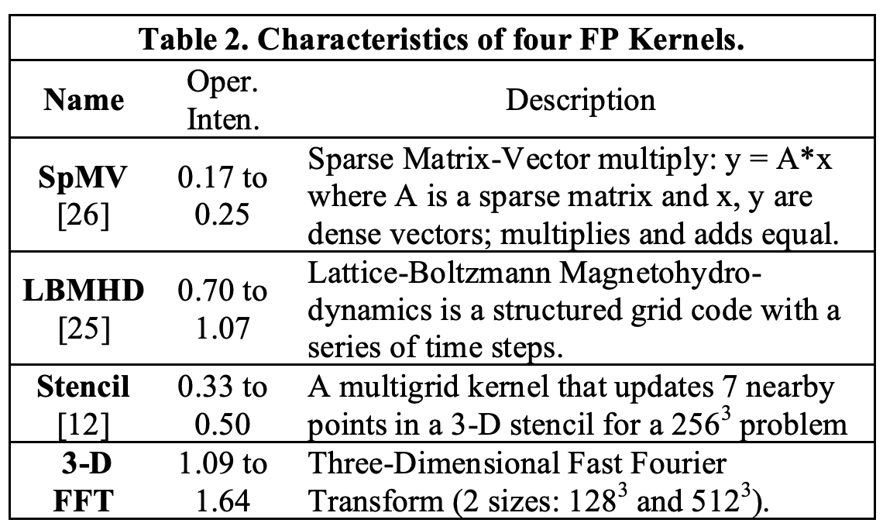
thoughts on paper
machines tested:
meh
kernels selected:
neet
fallacies discussed:
easy segue to important topics
overall:
nice graphic for things we should already kno
isaac stier robson
roofline
18 september 2019 31 / 33

Slide 32
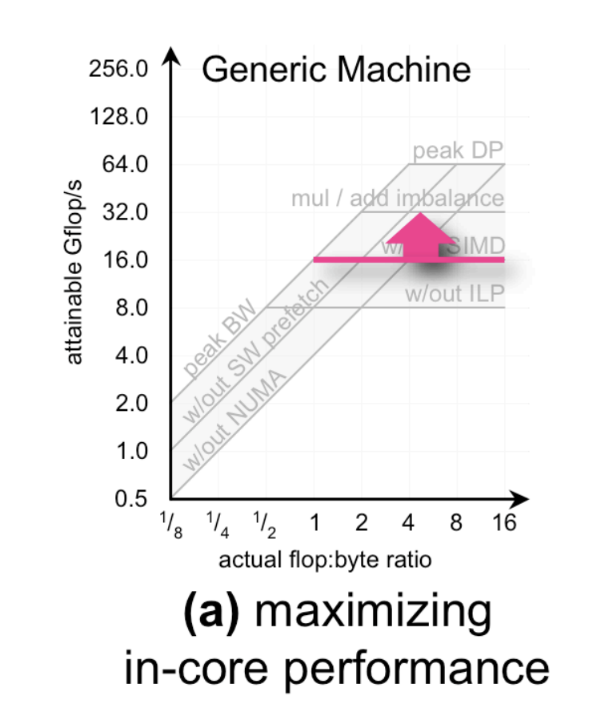
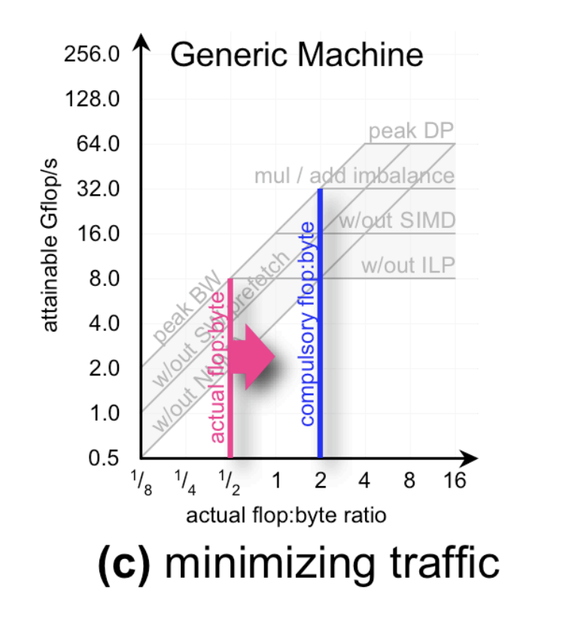
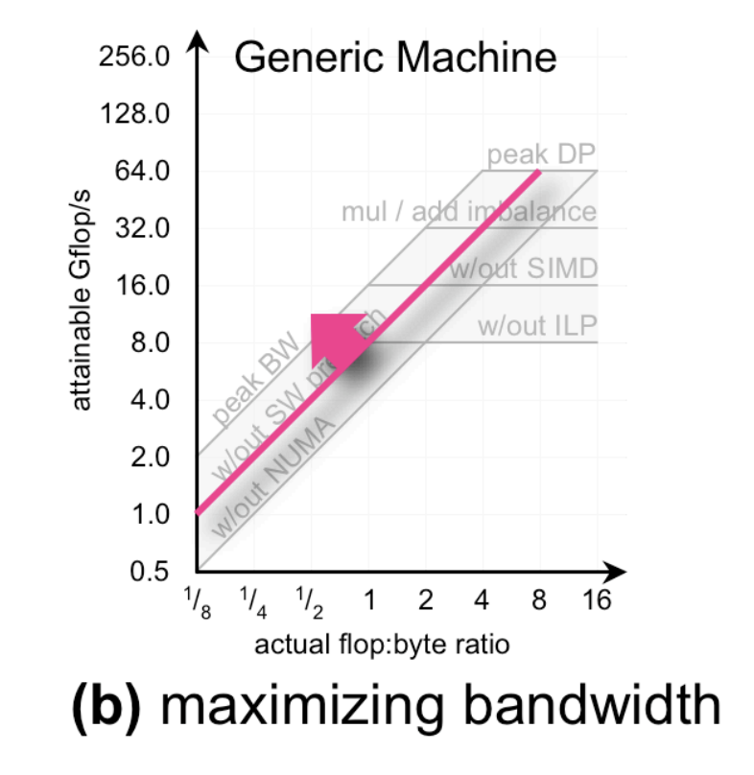
things we should already kno
isaac stier robson
roofline
18 september 2019 32 / 33

Slide 33
fin
isaac stier robson
roofline
18 september 2019 33 / 33

