Slide 1
warning: this presentation will be fast
in-datacenter performance analysis of a tensor processing unit
warning: this presentation will be
isaac stier robson
duke university
30 oct 2019

Slide 2
outline
tl;dr
authors / misc
all of neural networks in 3 minutes
motivation / “el problemo”
the tpu
flaws & future work
isaac stier robson
tpu
25 oct 2019 2 / 40

Slide 3
tl;dr

Slide 4
what is a tpu?
custom accelerator (asic) for matrix math (read deep neural networks)
inspired by gpus but more similar to floating-point units
notably the inference setting uses quantized (8-bit) floating point arithmetic (first tpu just for inference)
isaac stier robson
tpu
25 oct 2019 4 / 40

Slide 5
what is a tpu?
most salient feature is 65,536 multiplier-accumulators (macs)
“The philosophy of the TPU microarchitecture is to keep the matrix unit [aka the macs] busy”
….spooky
isaac stier robson
tpu
25 oct 2019 5 / 40

Slide 6
authors/misc

Slide 7
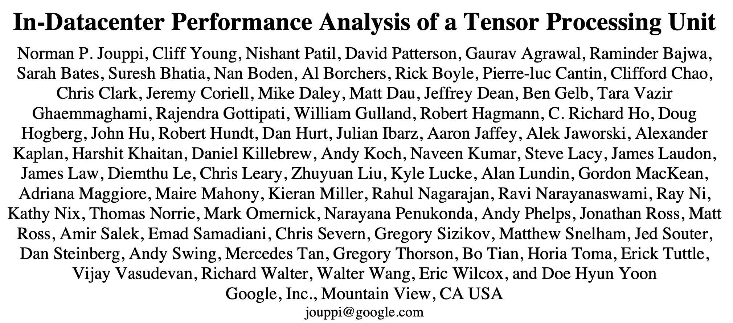
isaac stier robson
tpu
25 oct 2019 7 / 40

Slide 8
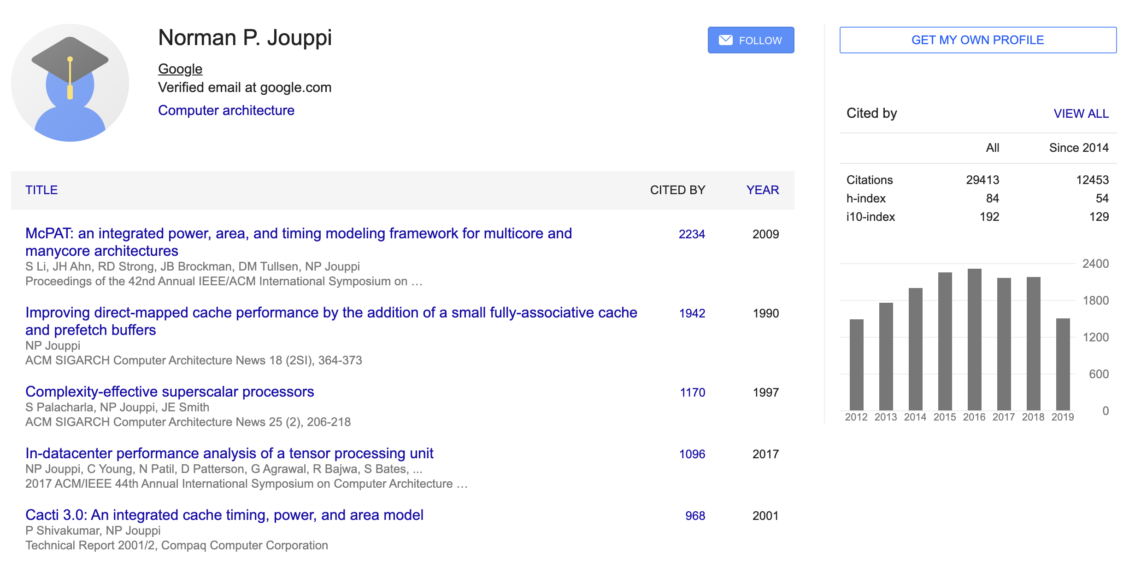
isaac stier robson
tpu
25 oct 2019 8 / 40

Slide 9
isaac stier robson
tpu
25 oct 2019 9 / 40

Slide 10
all of neural nets in 3 min

Slide 11
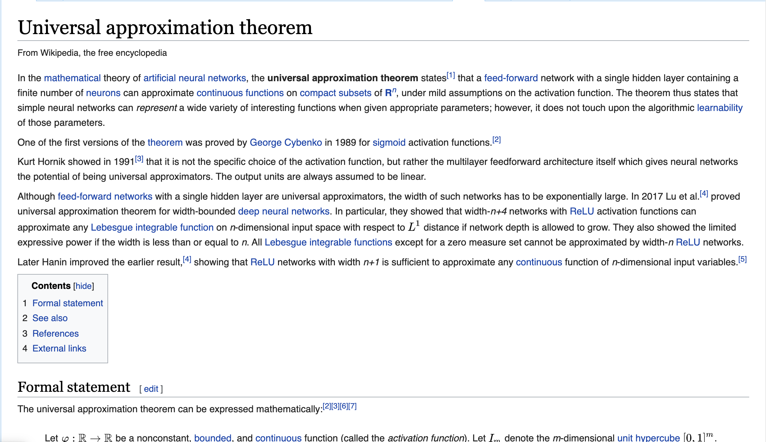
isaac stier robson
tpu
25 oct 2019 11 / 40

Slide 12
implications of the uat
neural networks might not be your favorite (a)statistical model…
you might not even like machine learning
but…
…it is possible to use them for a whole bunch of things…
…and we ain’t got much better
isaac stier robson
tpu
25 oct 2019 12 / 40

Slide 13
applications of the uat
autonomous vehicles
cancer drug discovery
precision agriculture
personalized learning
music synthesis
machine translation
synthetic neuroscience
art fraud discovery
genetic evolution modeling
accelerating the 3-body problem
chaotic systems modeling
e-commerce engines
automatic chassis engineering
robotic control
hardware chip design
climate change simulation
computer hacking/defense
facial recognition
discovering the higgs boson
materials engineering
rat language processing
speech to text
netflix recomendations
cat detectors
isaac stier robson
tpu
25 oct 2019 13 / 40

Slide 14
implementations of the uat
step 1) collect data
step 2) matrix multiply data
step 3) apply nonlinearity to data
step 4) compute loss against actual
step 5) gradient descent
step 6) turtles all the way down
Let X ∈ ℝ_{n x p} Y ∈ ℝ_{n} and 𝛽 ∈ ℝ_{p}
X’ := X𝛽
Ŷ := ReLU( X’ )
e = (Y – Ŷ)²
𝛽 -= α $\frac{∂\text{e}}{∂\text{β}}$
for α small
isaac stier robson
tpu
25 oct 2019 14 / 40

Slide 15
alternatives to the uat
????
panic
ask this guy?
isaac stier robson
tpu
25 oct 2019 15 / 40

Slide 16
“el problemo”
(motivation)

Slide 17
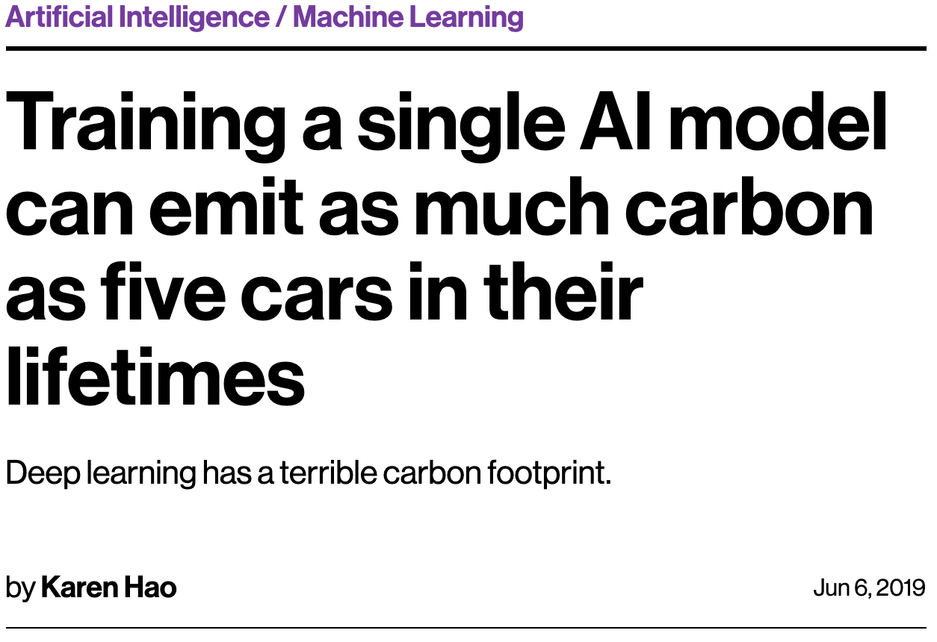
ramifications of the uat
isaac stier robson
tpu
25 oct 2019 17 / 40

Slide 18
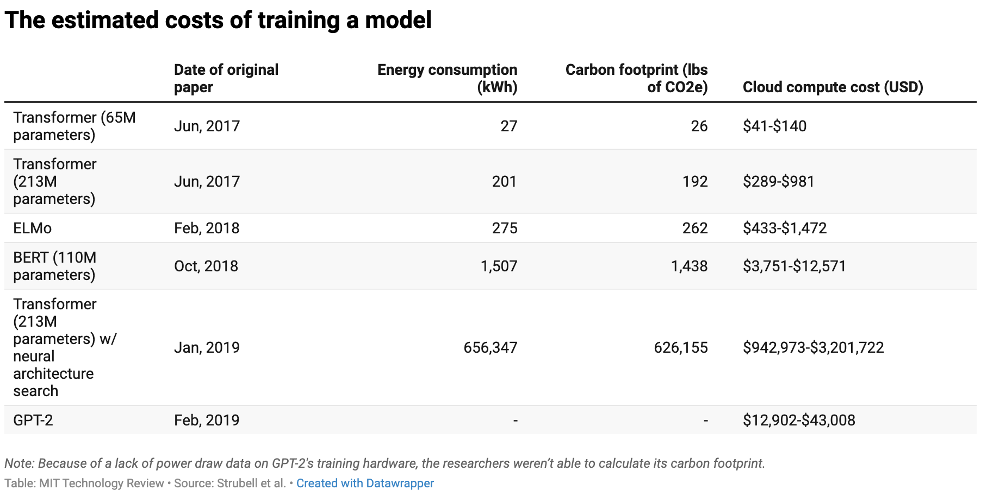
ramifications of the uat
isaac stier robson
tpu
25 oct 2019 18 / 40

Slide 19
the future of the uat
isaac stier robson
tpu
25 oct 2019 19 / 40

Slide 20
the future of the uat
“a [2013] projection showed people searching by voice for three minutes a day using speech recognition DNNs would double our datacenters’ computation demands”
isaac stier robson
tpu
25 oct 2019 20 / 40

Slide 21
softening of the uat (not all doom and gloom)
isaac stier robson
tpu
25 oct 2019 21 / 40

Slide 22
the tpu

Slide 23
the tpu
“the goal
was to improve cost-performance by 10X over gpus.
given this mandate, in
just 15 months
the tpu was
designed, verified [55], built, and deployed in datacenters."
isaac stier robson
tpu
25 oct 2019 23 / 40

Slide 24
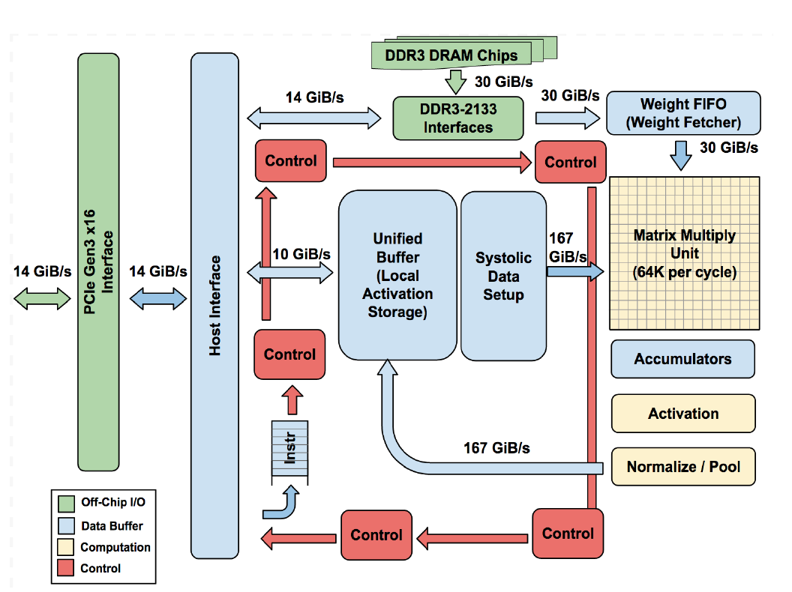
the tpu
“The philosophy of the TPU microarchitecture is to keep the matrix unit busy”
isaac stier robson
tpu
25 oct 2019 24 / 40

Slide 25
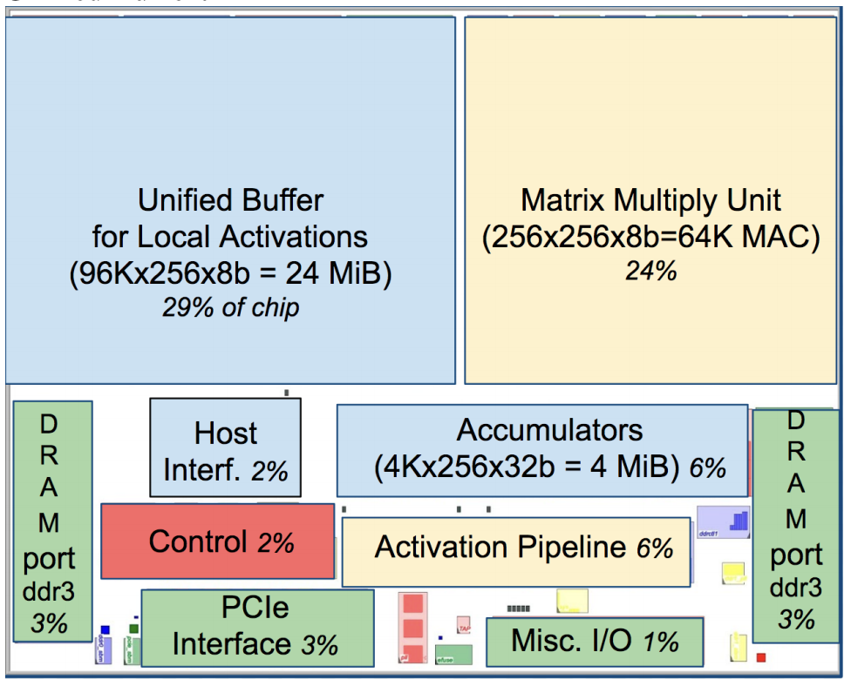
the tpu (actual floorplan)
“The philosophy of the TPU microarchitecture is to keep the matrix unit busy”
isaac stier robson
tpu
25 oct 2019 25 / 40

Slide 26
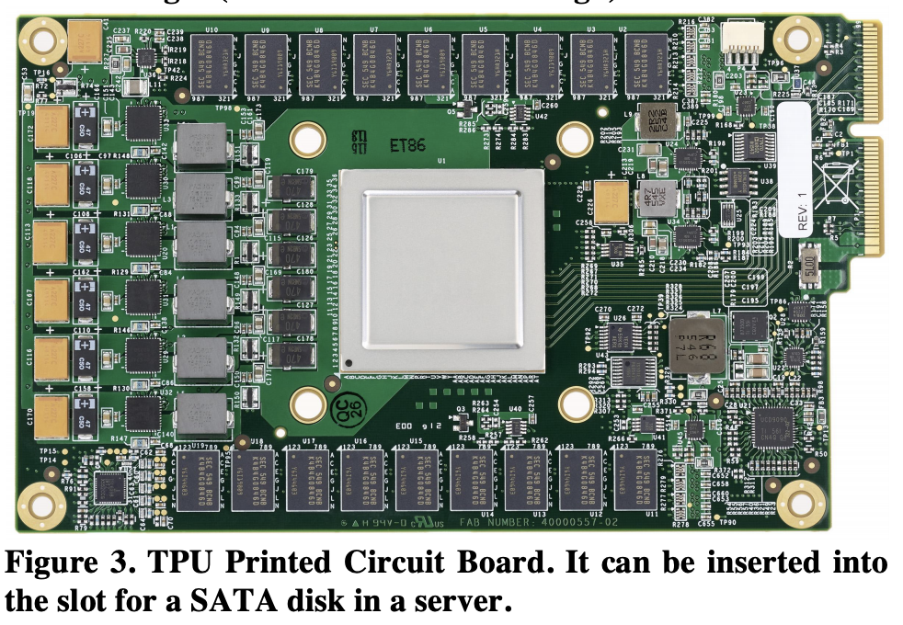
the tpu (sata disk size)
pls
ignore
me
isaac stier robson
tpu
25 oct 2019 26 / 40

Slide 27
the tpu (datapath/instructions)
“datapath is nearly two thirds of the die” (buffer, matmul, accum)
instructions “sent over relatively slow pcie bus”
cisc (not risc) with “[at least] 10 to 20 clock cycles per instruction”
no clean pipeline diagrams available as “cisc instructions can occupy a station for 1000s of clock cycles”
isaac stier robson
tpu
25 oct 2019 27 / 40

Slide 28
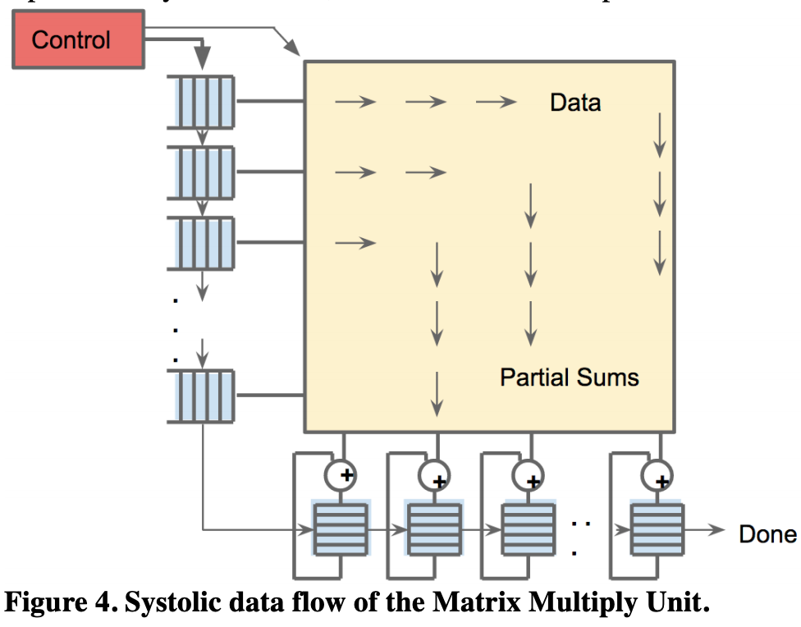
the tpu (datapath/instructions)
“raw pipeline stall [occurs between layers]… before safely reading from the unified buffer”
“256-element multiply-accumulate operation moves through the matrix as a diagonal wavefront”
“control and data are pipelined
to give the illusion that the 256 inputs are read at once…
[and that] they instantly update one location of each of 256 accumulators”
isaac stier robson
tpu
25 oct 2019 28 / 40

Slide 29
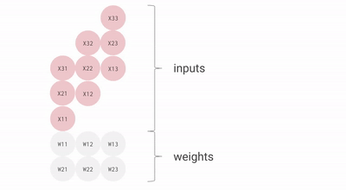
the tpu (datapath/instructions)
“[weights] preloaded, & take effect with the advancing wave alongside the first data of a new block”
“software is unaware of the systolic nature of the matrix unit…. [but] it does worry about the latency of the unit”
systolic matrix multiplication gif
https://cloud.google.com/blog/products/gcp/an-in-depth-look-at-googles-first-tensor-processing-unit-tpu
isaac stier robson
tpu
25 oct 2019 29 / 40

Slide 30
the tpu (datapath/instructions)
5 main instructions:
i. Read_Host_Memory
ii. Read_Weights
iii. MatrixMultiply/Convolve
iv. Activate
v. Write_Host_Memory
isaac stier robson
tpu
25 oct 2019 30 / 40

Slide 31
the tpu (lo-fi af)
another unique feature of the tpu is its
8-bit quantized floating point precision
isaac stier robson
tpu
25 oct 2019 31 / 40

Slide 32
the tpu (lo-fi af)
quantization = lossy math
https://cloud.google.com/blog/products/gcp/an-in-depth-look-at-googles-first-tensor-processing-unit-tpu
is it a bad idea?
isaac stier robson
tpu
25 oct 2019 32 / 40

Slide 33
the tpu (lo-fi af)
first, some software
isaac stier robson
tpu
25 oct 2019 33 / 40

Slide 34
the tpu (lo-fi af)
batch norm stabilizes each layer’s output to smallish values
when used, this means there is a low probability any one layer has ‘giant’ weights or gradients this provides a genuine accuracy/training benefit and
isaac stier robson
tpu
25 oct 2019 34 / 40

Slide 35
the tpu (lo-fi af)
batchnorm contracts the data back to zero
meaning that quantized arithmetic can take place without large numbers
so the step size δ between two consecutive numbers can be small (read >>> little loss)
isaac stier robson
tpu
25 oct 2019 35 / 40

Slide 36
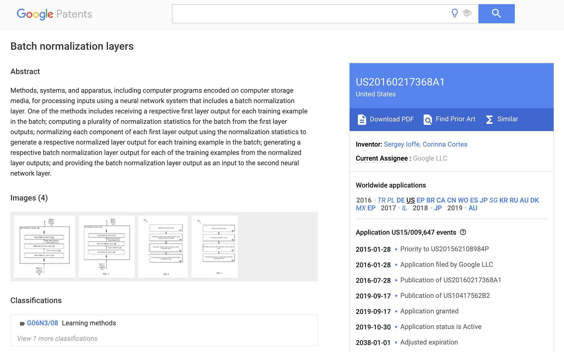
the tpu (lo-fi af)
isaac stier robson
tpu
25 oct 2019 36 / 40

Slide 37
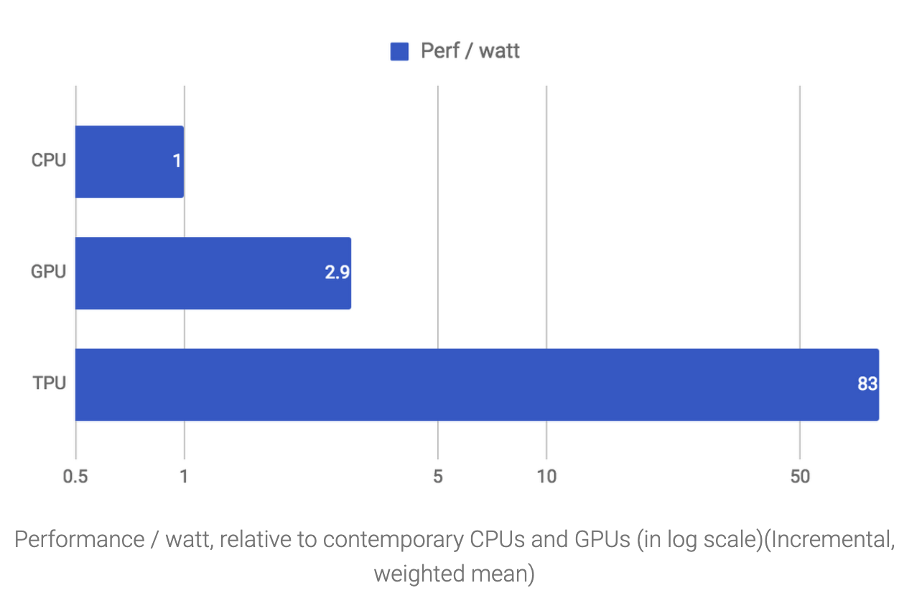
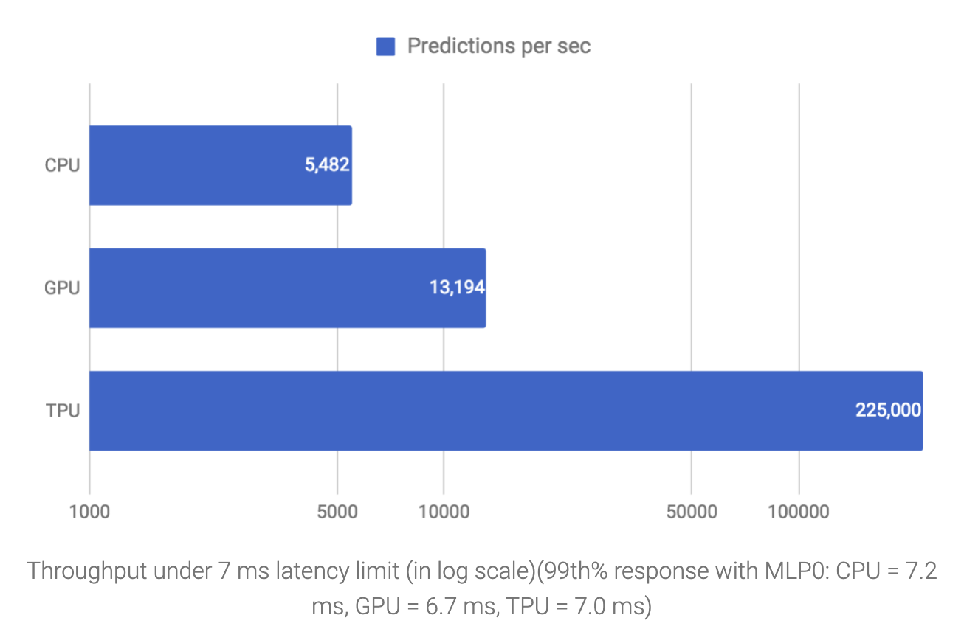
performance
isaac stier robson
tpu
25 oct 2019 37 / 40

Slide 38
flaws & future work

Slide 39
maire mahony systems hardware engineer @ google
openpower summit, 2018
isaac stier robson
tpu
25 oct 2019 39 / 40

Slide 40
the edge
isaac stier robson
tpu
25 oct 2019 40 / 40

