Slide 1
the mondrian data engine
isaac stier robson
duke university
20 nov 2019

Slide 2
the mondrian computer inspired by dutch artist piet mondrian
isaac stier robson
mondrian
20 nov 2019 2 / 31

Slide 3
outline
tl;dr
spark sql
nmp & mem access
mondrian
performance
isaac stier robson
mondrian
20 nov 2019 3 / 31

Slide 4
tl;dr

Slide 5
tl;dr somewhat related
“we began to ask, why should the processor be the [queen or] king?
the data should be king [or queen].
the data needs to be near the processing elements and we had to minimize data movement.”
m. rosenfield of ibm
on ibm summit
isaac stier robson
mondrian
20 nov 2019 5 / 31

Slide 6
tl;dr
data-intensive applications keep getting more data-intensive
in addition to restructured datacenters, architectures themselves are evolving
growing field of near-memory processing (nmp)
relies on die-stacking technology
“enables the tight integration of logic and memory while still allowing separate chip manufacturing”
isaac stier robson
mondrian
20 nov 2019 6 / 31

Slide 7
tl;dr
“our thesis is that efficient nmp calls for an algorithm-hardware co-design”
“algorithms with sequential accesses to enable simple hardware that accesses memory in streams”
“data objects in a hash table bucket — similarly, in a memory partition — are permutable”
- mondrian team
isaac stier robson
mondrian
20 nov 2019 7 / 31

Slide 8
spark sql

Slide 9
spark these ain’t yo’ grandma’s dataframes
“…spark has been shown to work well up to petabytes.
it has been used to sort 100 tb of data 3X faster than hadoop mapreduce on 1/10th of the machines,
winning the 2014 daytona graysort benchmark”
- spark faq
http://sortbenchmark.org/
isaac stier robson
mondrian
20 nov 2019 9 / 31

Slide 10
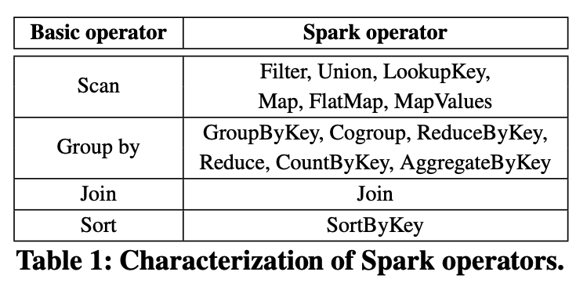
spark where they got the first algos for mondrian from
hashes, concats, and foralls
hashes and reductions
hash/lookup/merge
pls see compsci 330
isaac stier robson
mondrian
20 nov 2019 10 / 31

Slide 11
spark separable into two phases: partitioning & probing
isaac stier robson
mondrian
20 nov 2019 11 / 31

Slide 12
nmp & mem access

Slide 13
isaac stier robson
mondrian
20 nov 2019 13 / 31

Slide 14
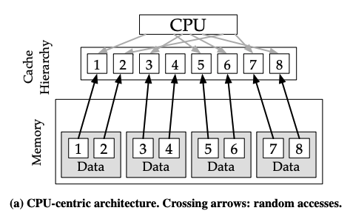
nmp vs. cpu-centric architectures
cpu-centric <> centralization
transfer “all data from the memory close to the processor”
several memory partitions typical
some might be closer (numa)
but all still high access cost
“rely on high locality & reuse in their cache hierarchy for [efficiency]”
isaac stier robson
mondrian
20 nov 2019 14 / 31

Slide 15
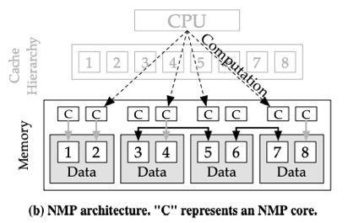
nmp nmp style
nmp still has several mem partitions
however, partition-localized compute handles much of the work
unfortunately, gather/scatter still require a lot of non-local data
thus, during partitioning, data is shuffled across partition (black lines in right diagram)
isaac stier robson
mondrian
20 nov 2019 15 / 31

Slide 16
mem access micron hmc
mondrian relies on micron hmc, an incombatible competitor to
high-memory bandwidth (hmb)
ddr[n] (i.e. ddr4)
supports small cache-blocks et al (8B to 256B)
won lots of awards in 2011…. discontinued in 2018
micron now working on gddr6
micron hmc promotional graphic
isaac stier robson
mondrian
20 nov 2019 16 / 31

Slide 17
mem access author notes
“in general, maximizing dram’s efficiency… requires sequential accesses”
“for ddr3, the row activation energy is 3× higher than the energy of transferring a cache block from/to the row buffer” [changes w/ block size]
“efficiency requires amortization of the row activation cost by leveraging row buffer locality“
to enable these speedups, mondrian focuses on coarse-grained data partitioning (permutability)
isaac stier robson
mondrian
20 nov 2019 17 / 31

Slide 18
mondrian

Slide 19
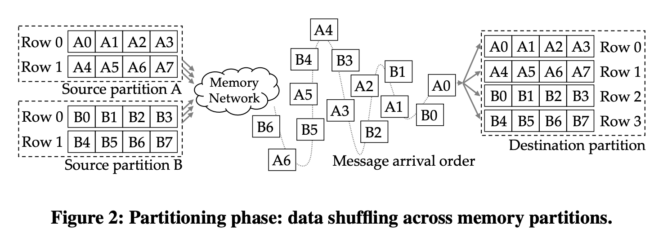
mondrian data permutability
shuffling ordered data across nodes results in out-of-order arrival issues
somewhat alleviated by multiple open dram rows (not scalable)
isaac stier robson
mondrian
20 nov 2019 19 / 31

Slide 20
mondrian data permutability
mondrian thus exploits commutativity of many low-level data operators
during partitioning phase, simply dumps data to coarse-grained hash bucket
this requires
enforcing software accesses these buckets sequentially
lots of sorting (done via streaming mergesort)
additionally, this prohibits skewn datasets
leave this to future work
requires uniform distribution <> likely a big problem with adoption
isaac stier robson
mondrian
20 nov 2019 20 / 31

Slide 21
mondrian sorting
mondrian uses 8B/8B key/value tuples
estimate “streams of 16B tuples” sortable
via an 8-tuple-wide SIMD unit
to hit the the 8GB/s per-vault memory bandwidth
also improve mergesort “with an initial bitonic sort pass” in simd
pick the arm cortex-35 to as primary worker
flexible configuration
supports more efficient fixed-point logic
isaac stier robson
mondrian
20 nov 2019 21 / 31

Slide 22
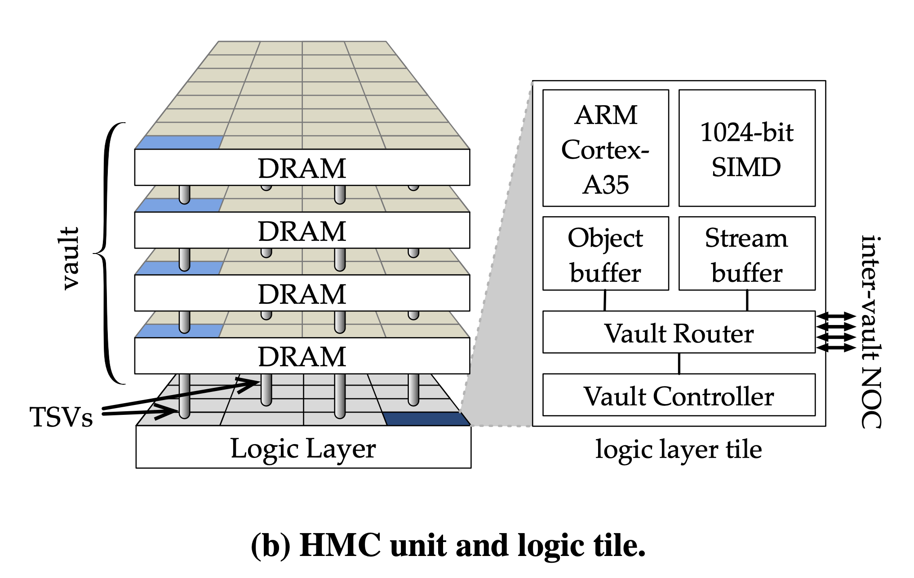
mondrian diagrams
isaac stier robson
mondrian
20 nov 2019 22 / 31

Slide 23
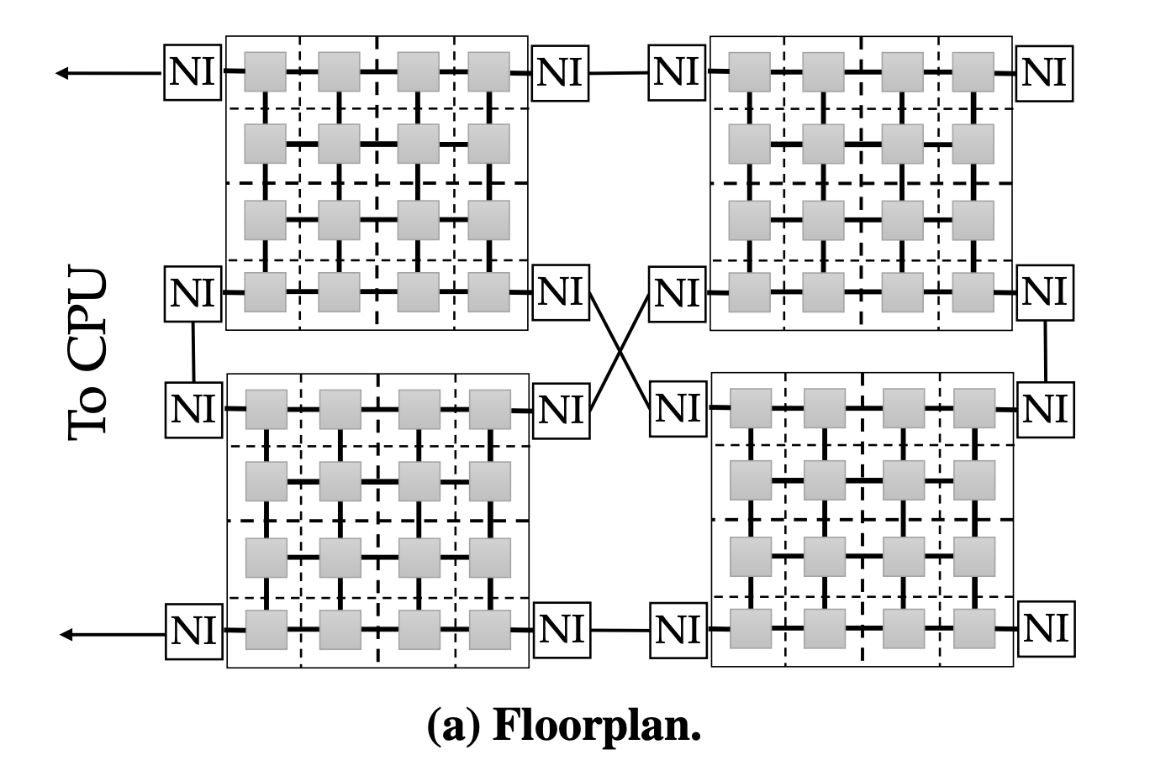
mondrian diagrams
isaac stier robson
mondrian
20 nov 2019 23 / 31

Slide 24
performance

Slide 25
performance
interesting paragraph
for group by and join:
nmp-rand > nmp-seq
despite nmp-seq’s instructions per cycle = 0.95
nmp-rand’s instructions per cycle = 0.24
isaac stier robson
mondrian
20 nov 2019 25 / 31

Slide 26
performance
interesting paragraph
while nmp-seq faster
“due to sequential memory access patterns”
“not fast enough to compensate for the added logn factor to algorithmic complexity [from sorting]”
mondrian’s wide simd units
“absorb this algorithmic complexity bump”
“speedups of 22× over the cpu and 5× over the best nmp”
isaac stier robson
mondrian
20 nov 2019 26 / 31

Slide 27
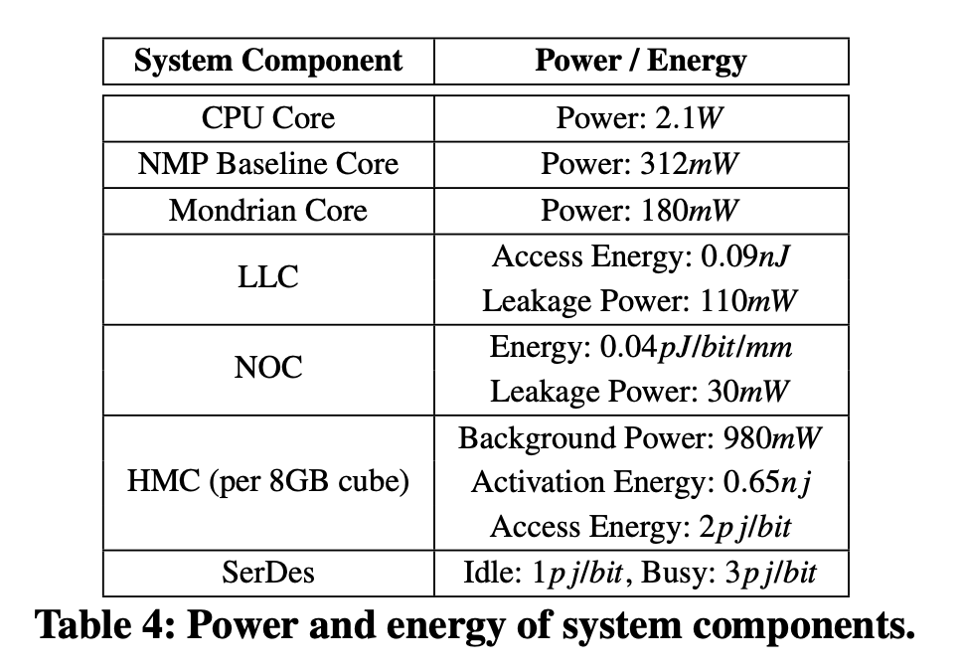
performance
power draw
simulated with: flexus [full-system cycle-accurate simulator], + dramsim2
isaac stier robson
mondrian
20 nov 2019 27 / 31

Slide 28
performance
speedup
simulated with: flexus [full-system cycle-accurate simulator], + dramsim2
isaac stier robson
mondrian
20 nov 2019 28 / 31

Slide 29
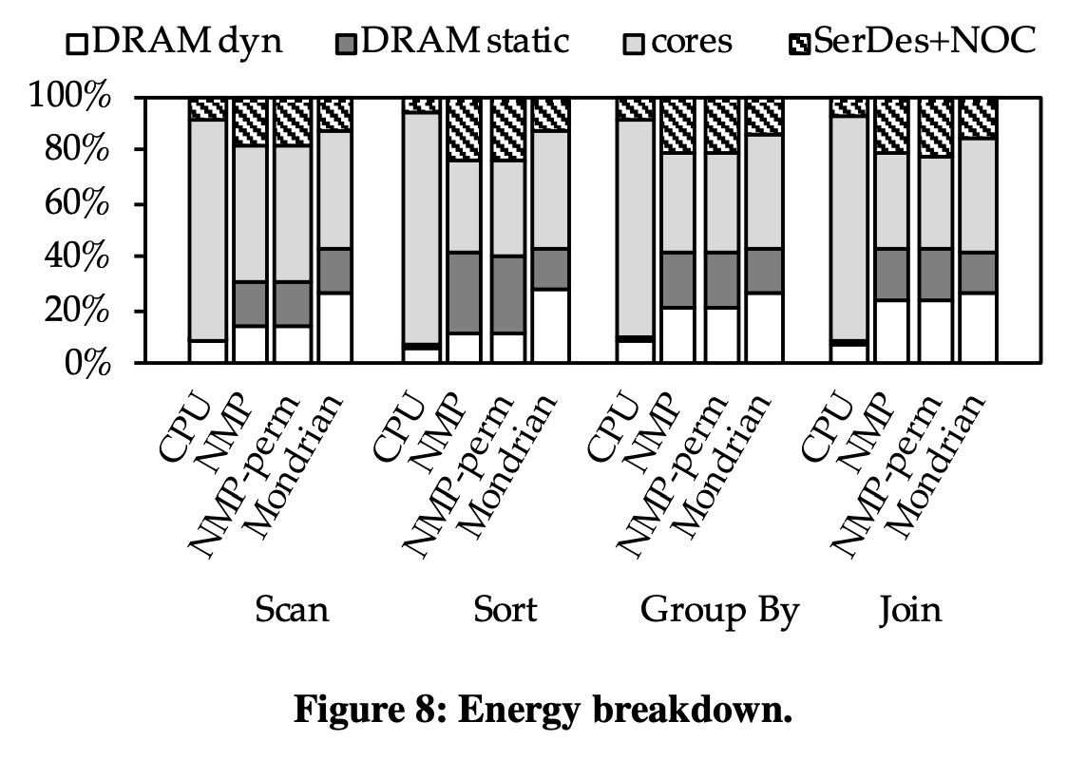
performance
relative energy usage
trying to show they decreased core energy usage w/o the noc cost of nmp31?
not clear at all…. relative usage`
simulated with: flexus [full-system cycle-accurate simulator], + dramsim2
isaac stier robson
mondrian
20 nov 2019 29 / 31

Slide 30
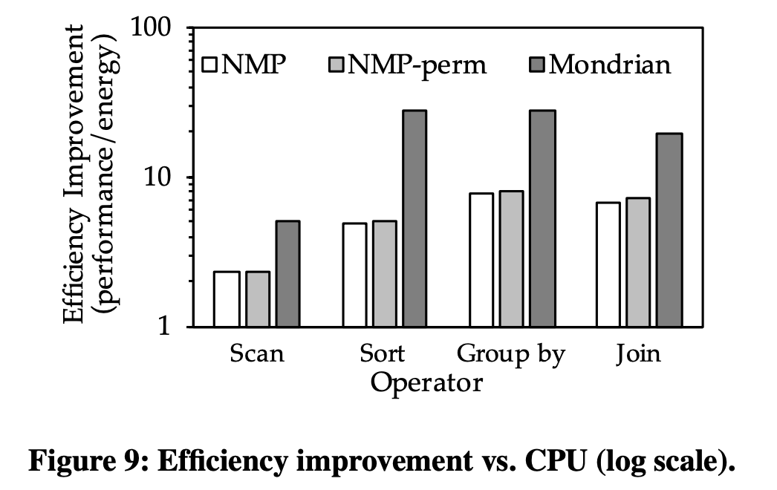
performance
absolute energy efficiency
simulated with: flexus [full-system cycle-accurate simulator], + dramsim2
isaac stier robson
mondrian
20 nov 2019 30 / 31

Slide 31
discussion

