Slide 1
darwin:
a genomics co-processor provides up to 15,000× acceleration on long read assembly
isaac stier robson
duke university
4 nov 2019

Slide 2
darwin’s pet food
https://www.darwinspet.com/cat-food/

Slide 3
outline
tl;dr
bio bckgd
motivation
big picture of darwin
isaac stier robson
darwin
4 nov 2019 3 / 34

Slide 4
tl;dr

Slide 5
tl;dr
cost of genetic data
isaac stier robson
darwin
4 nov 2019 5 / 34

Slide 6
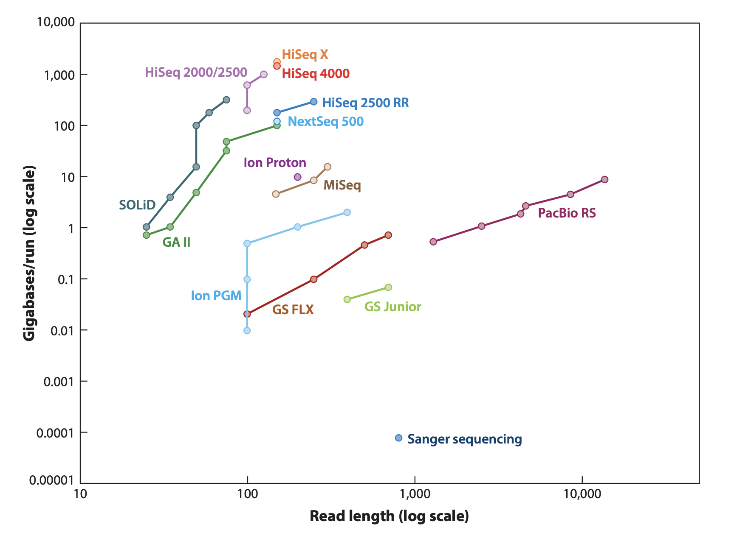
tl;dr
read length* & size of collected genomes
https://www.annualreviews.org/doi/pdf/10.1146/annurev-genom-083115-022413
isaac stier robson
darwin
4 nov 2019 6 / 34

Slide 7
tl;dr
“Despite several advantages,
the long read technology suffers from one major drawback
- high error rate in sequencing”
isaac stier robson
darwin
4 nov 2019 7 / 34

Slide 8
tl;dr
“These errors are corrected using computational methods that can be
orders of magnitude slower than those used for the second generation technologies”
isaac stier robson
darwin
4 nov 2019 8 / 34

Slide 9
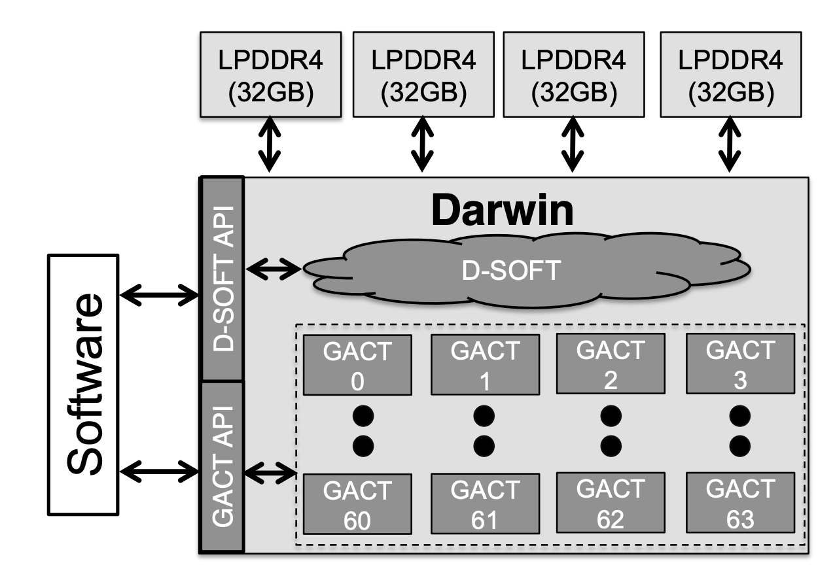
tl;dr
filtration queue (alignment preproc)
long read
alignment
darwin system overview
isaac stier robson
darwin
4 nov 2019 9 / 34

Slide 10
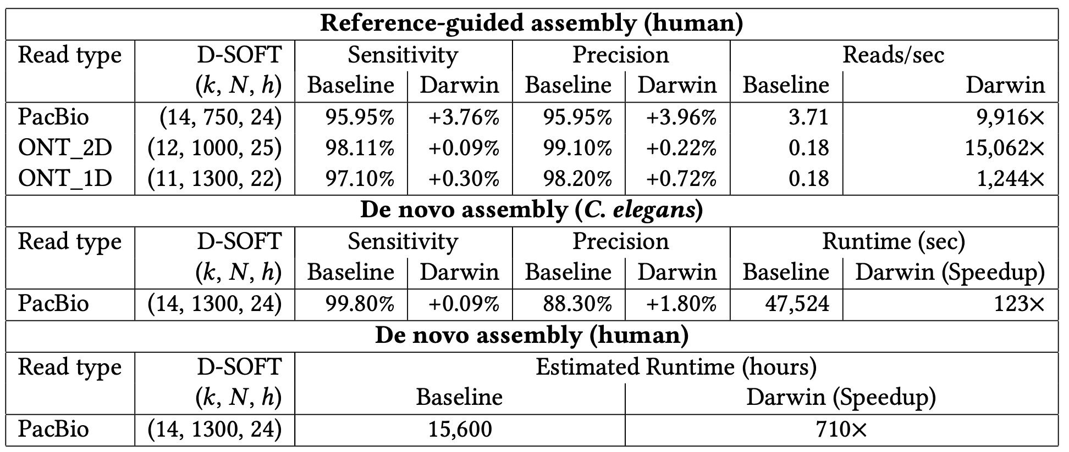
tl;dr
darwin reported results
isaac stier robson
darwin
4 nov 2019 10 / 34

Slide 11
tl;dr
darwin fpga & asic provide significant speedup (compared to software)
for both de novo and reference-guided assembly of a genome at an acceptable sensitivity
darwin’s bottleneck (for author’s choice of parameters) is dram bandwidth (not a trivial result)
isaac stier robson
darwin
4 nov 2019 11 / 34

Slide 12
bio bckgd

Slide 13
bio bckgd
https://www.genome.gov/about-genomics/fact-sheets/Sequencing-Human-Genome-cost
isaac stier robson
darwin
4 nov 2019 13 / 34

Slide 14
bio bckgd coverage
“shearing dna molecules of the genome into a large number n of random fragments”
n “chosen such that each base-pair of the genome g is expected to be covered more than once”
“long-read sequencing technologies… have a mean read length 𝓁 of about 10Kbp”
isaac stier robson
darwin
4 nov 2019 14 / 34

Slide 15
bio bckgd coverage
c <> coverage
c = n * 𝓁 / g
n <> # random fragments
g <> genome size
𝓁 <> read length
isaac stier robson
darwin
4 nov 2019 15 / 34

Slide 16
motivation

Slide 17
causes of cancer
“Although all cancers are a result of multiple mutations...
…[90-95% of cancers] are due to interaction with the environment”
“Cancer is a Preventable Disease that Requires Major Lifestyle Changes”
Anand et al. (2008)
https://www.ncbi.nlm.nih.gov/pmc/articles/PMC2515569/
isaac stier robson
darwin
4 nov 2019 17 / 34

Slide 18
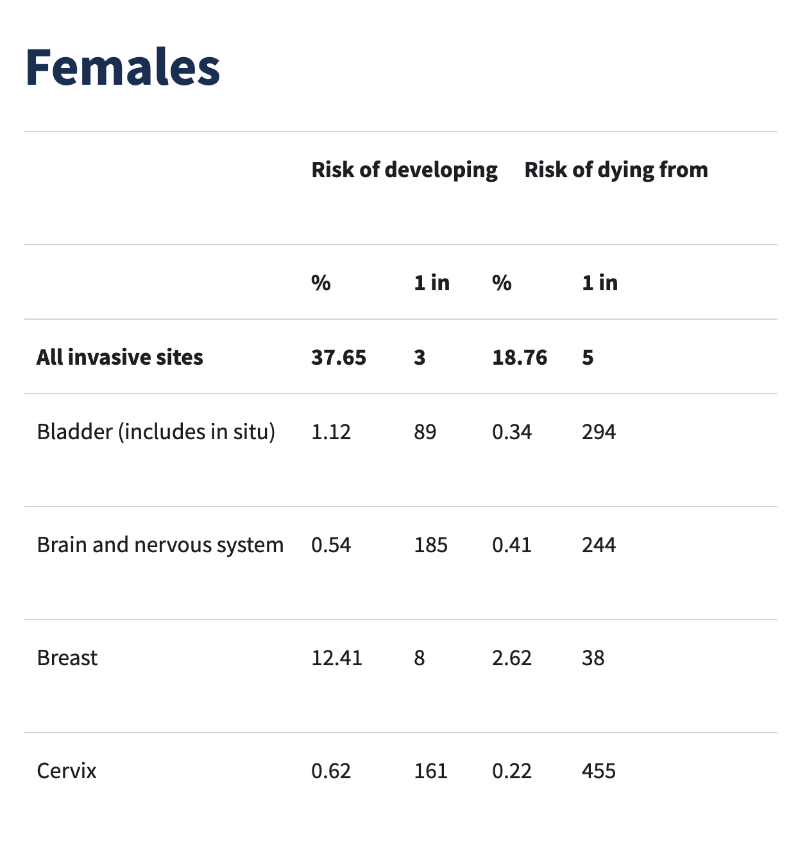
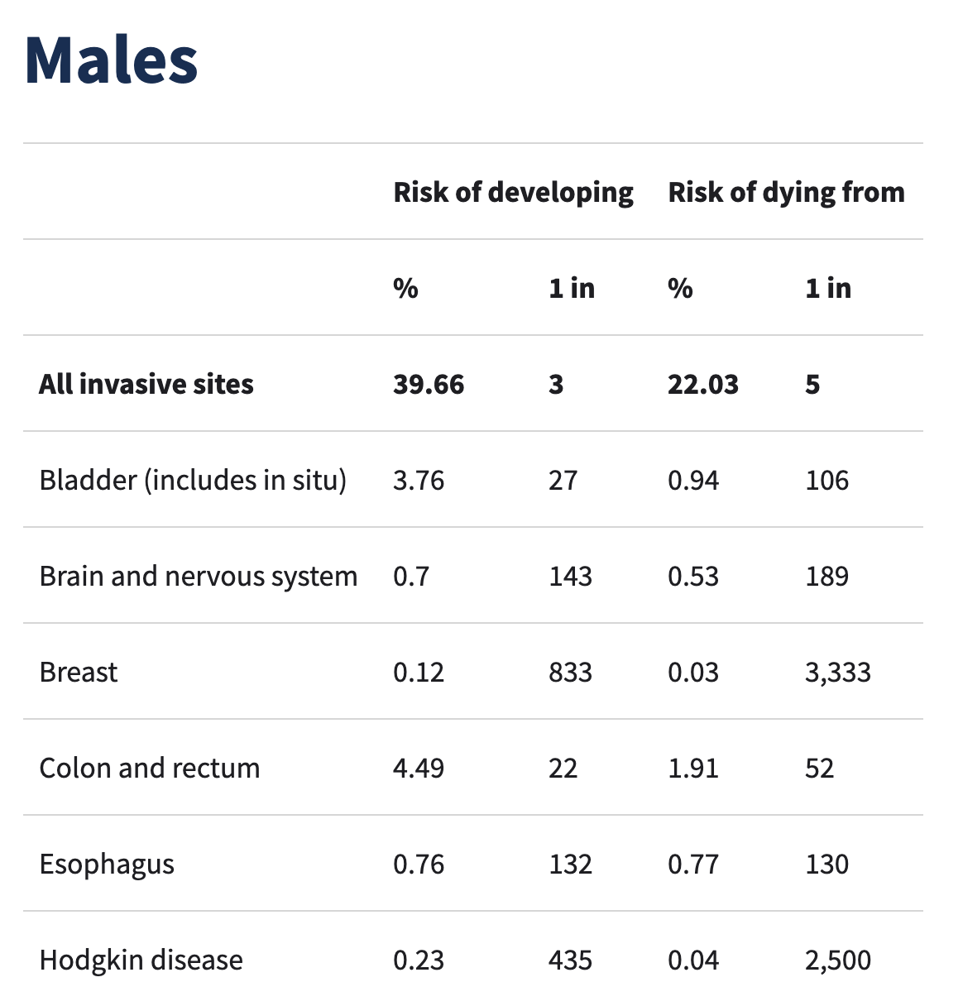
lifetime risk of cancer in xx and xy american cancer society https://www.cancer.org/cancer/cancer-basics/lifetime-probability-of-developing-or-dying-from-cancer.html
isaac stier robson
darwin
4 nov 2019 18 / 34

Slide 19
genomics data is a lot of work daligner: de novo alignment job
“For example, on the Pacbio 54X human data set, daligner took 15,600 CPU hours on our
modest 480 core HPC cluster,
and as a monolithic run would have required at least 12Tb of memory!”
https://dazzlerblog.wordpress.com/2014/07/10/dalign-fast-and-sensitive-detection-of-all-pairwise-local-alignments/
isaac stier robson
darwin
4 nov 2019 19 / 34

Slide 20
big picture of darwin

Slide 21
string alignment
dynamic programming
formulation
likely alignment score
cost matrix
traceback
isaac stier robson
darwin
4 nov 2019 21 / 34

Slide 22
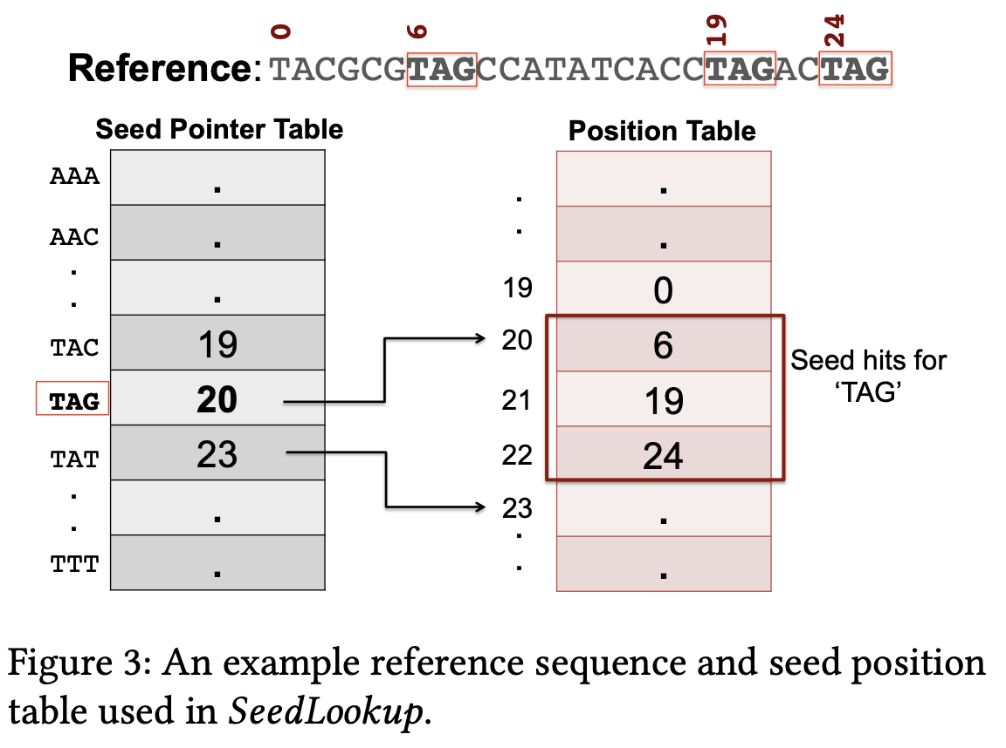
stochastic string alignment “do not guarantee optimal alignments but have linear s & t complexity”
take a substring (seed)
find matches
(d-soft)
isaac stier robson
darwin
4 nov 2019 22 / 34

Slide 23
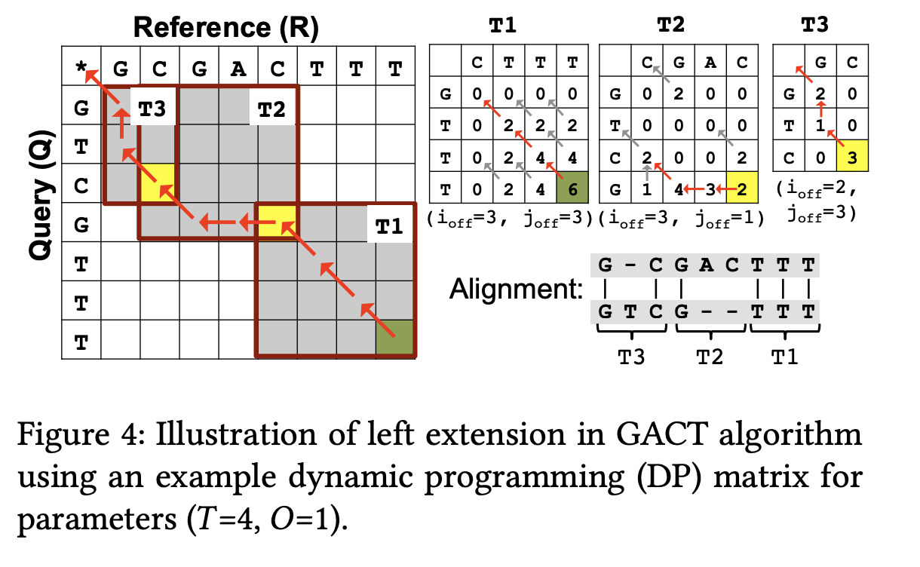
stochastic string alignment “do not guarantee optimal alignments but have linear s & t complexity”
avoid computing parts of dp table
(gact)
isaac stier robson
darwin
4 nov 2019 23 / 34

Slide 24
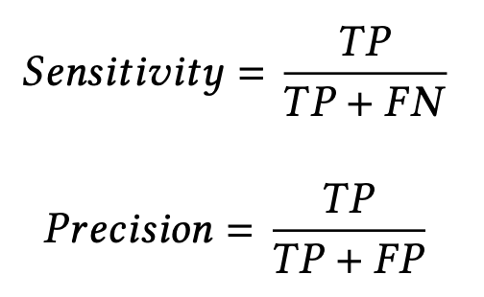
stochastic…. stuff
as the alignment step is stochastic in nature, certain prominent statistical features determine the benefit
on the filtration (d-soft) stage:
low sensitivity <> missing genome
low precision <> more work for gact
isaac stier robson
darwin
4 nov 2019 24 / 34

Slide 25
why it matters
graphmap is a prior solution focusing on high precision (reduce false positives)
this is due to computational expense of alignment step in software
darwin instead allows lower precision with 560x false positives
isaac stier robson
darwin
4 nov 2019 25 / 34

Slide 26
stochastic…. stuff
“alignment to filter the false hits takes 99.7% of the runtime and results in a 2.1× slowdown”
“worse for software but greatly benefits hardware-acceleration…
where the costs for dynamic programming, which requires few memory references, are significantly lower.
this algorithm-architecture co-optimization is central to the speedup of darwin”
isaac stier robson
darwin
4 nov 2019 26 / 34

Slide 27
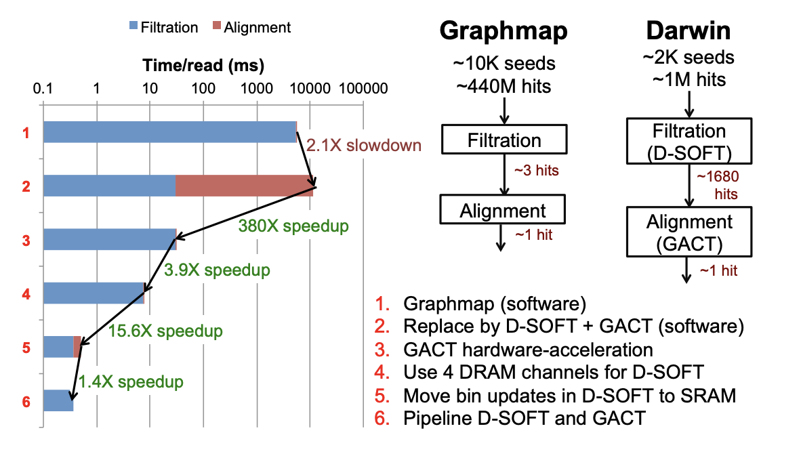
stochastic…. stuff
isaac stier robson
darwin
4 nov 2019 27 / 34

Slide 28
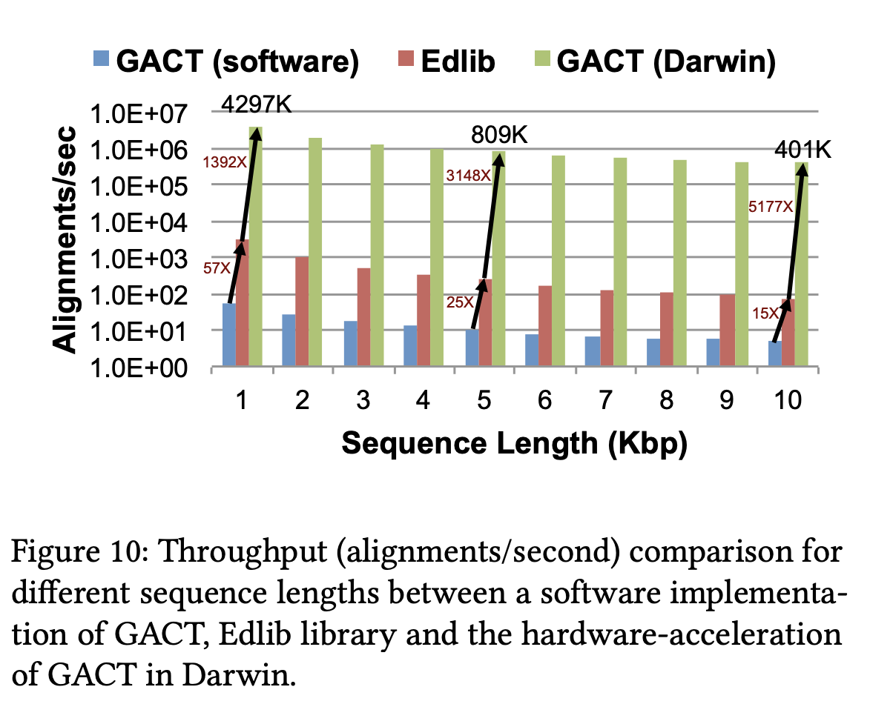
gact analysis
isaac stier robson
darwin
4 nov 2019 28 / 34

Slide 29
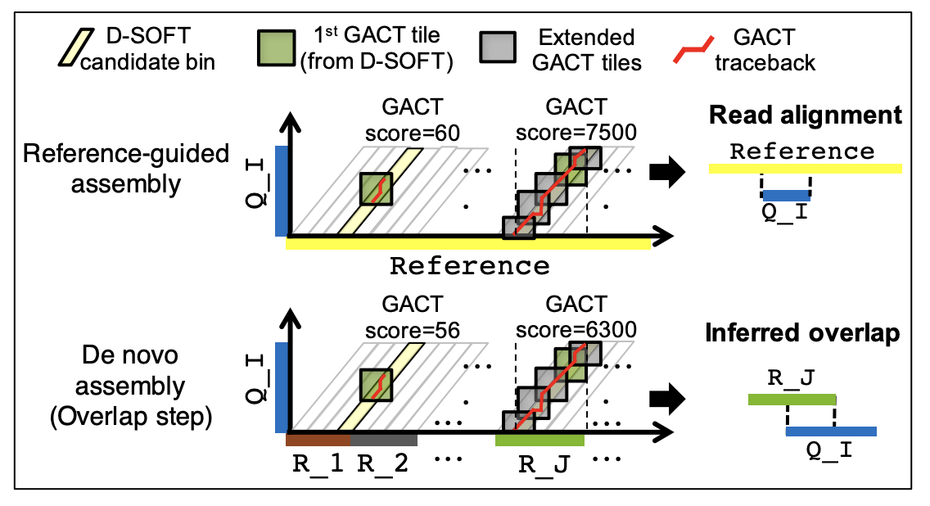
reference vs de novo
isaac stier robson
darwin
4 nov 2019 29 / 34

Slide 30
misc

Slide 31
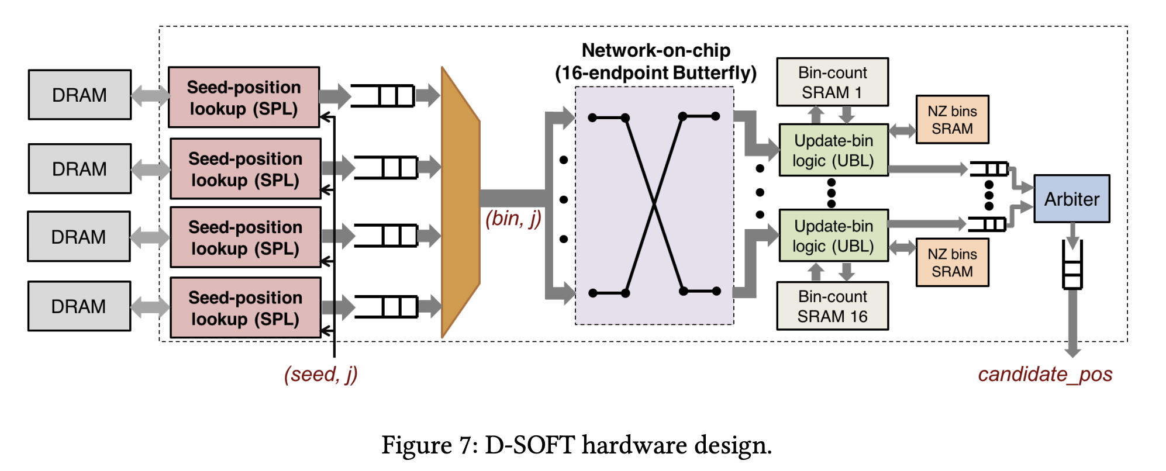
misc
isaac stier robson
darwin
4 nov 2019 31 / 34

Slide 32
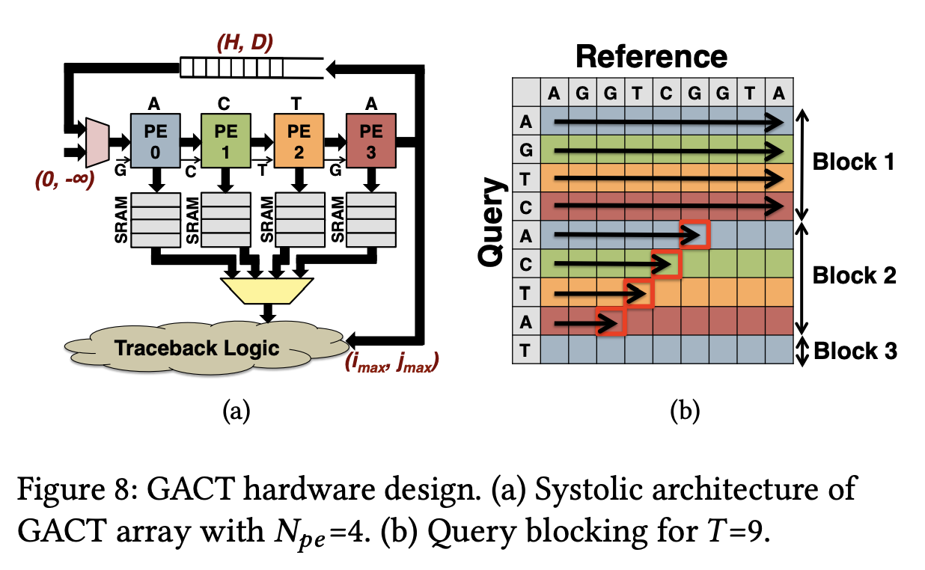
misc
isaac stier robson
darwin
4 nov 2019 32 / 34

Slide 33
misc
darwin reported results
isaac stier robson
darwin
4 nov 2019 33 / 34

Slide 34
fin

