Slide 1
event-centric narratives:
chambers + jurafsky (2008)
isaac stier robson
comp 790–158
17 jan 2020

Slide 2
isaac stier robson
event-centric narratives
17 jan 2020 2 / 62

Slide 3
outline
tl;dr
motivation
background
coreferences
cloze task
stanford parser
scripts + script learning
chambers + jurafsky (2008)
discussion
isaac stier robson
event-centric narratives
17 jan 2020 3 / 62

Slide 4
tl;dr

Slide 5
tl;dr chambers + jurafsky (2008)
propose extracting partially ordered sets of events for downstream nlu tasks
called narrative event chain
three steps to creating:
event induction (recognizing events)
temporal ordering (sorting events)
structured selection (grouping events into chains)
https://www.aclweb.org/anthology/P08-1090/
isaac stier robson
event-centric narratives
17 jan 2020 5 / 62

Slide 6
tl;dr chambers + jurafsky (2008)
score narrative event chains with two methods:
narrative cloze (metric = rank):
fill in the blank for events
event = (verb, dependency) tuples
order coherence (metric = classification accuracy):
decide which events are before others
done pairwise
isaac stier robson
event-centric narratives
17 jan 2020 6 / 62

Slide 7
tl;dr chambers + jurafsky (2008)
key ideas in narrative event chains:
unsupervised way to learn scripts & frames
centering influenced event induction method (recognizing events)
as presented, requires a pipeline of other trained models (not end-to-end)
goal to be useful for nlu
isaac stier robson
event-centric narratives
17 jan 2020 7 / 62

Slide 8
tl;dr chambers + jurafsky (2008)
inference
order coherence accuracy
stanford parser
part of speech
temporal classifier
events + typed dependencies
gigaword
narrative
event chains
agglomerative clustering
narrative events
opennlp coreference
protagonist
pairwise mutual info
narrative cloze rank
coreferences
isaac stier robson
event-centric narratives
17 jan 2020 8 / 62

Slide 9
tl;dr chambers + jurafsky (2008)
training
wordnet synsets
timebank
stanford parser
temporal classifier
penn treebank
pre-trained,
supervised
pre-trained,
supervised
agglomerative clustering
narrative events
n / a
???
opennlp coreference
???
pairwise mutual info
corpus-specific,
unsupervised
isaac stier robson
event-centric narratives
17 jan 2020 9 / 62

Slide 10
motivation

Slide 11
motivation natural language
natural language is a powerful means of information sharing
it is flexible enough to convey
ideas (this slide!)
emotions (joy)
needs (hunger)
etc.
however, it requires a good deal of implicit (common sense, discourse-specific, etc.) and explicit (nearby words) context
isaac stier robson
event-centric narratives
17 jan 2020 11 / 62

Slide 12
motivation contexts -- authorship
i can shake off everything as i write; my sorrows disappear, my courage is reborn
– the diary of a young girl anne frank
isaac stier robson
event-centric narratives
17 jan 2020 12 / 62

Slide 13
motivation events
one of the many (frequently explicit) contexts in a narrative is an event
despite existence being a continuum, we discretize experience in language
“i had an exam”
“a chemical reaction occurs”
“the week passed”
for now, events == some action (verb) occurring (not uncommon in nlp community)
regardless of definition, events can have an impact!
isaac stier robson
event-centric narratives
17 jan 2020 13 / 62

Slide 14
motivation impact of events
perhaps it’s true that things can change in a day. that a few dozen hours can affect the outcome of whole lifetimes.
and that when they do, those few dozen hours, like the salvaged remains of a burned house—the charred clock, the singed photograph, the scorched furniture—must be resurrected from the ruins and examined. preserved. accounted for.
little events, ordinary things, smashed and reconstituted. imbued with new meaning. suddenly they become the bleached bones of a story.
– the god of small things arundhati roy
isaac stier robson
event-centric narratives
17 jan 2020 14 / 62

Slide 15
background coreferences

Slide 16
background coreference
(most) texts involve entities
when there are multiple mentions of the same entity, we call them coreferences
simple example:
pronoun-antecedent relationships
“the cat sat on the mat, then it got up and walked around”
coreference resolution is actually quite complicated…
for details, consult cs224n https://www.youtube.com/watch?v=i19m4GzBhfc
isaac stier robson
event-centric narratives
17 jan 2020 16 / 62

Slide 17
background coreference
perhaps it’s true that things can change in a day. that a few dozen hours can affect the outcome of whole lifetimes.
and that when they do, those few dozen hours, like the salvaged remains of a burned house—the charred clock, the singed photograph, the scorched furniture—must be resurrected from the ruins and examined. preserved. accounted for.
little events, ordinary things, smashed and reconstituted. imbued with new meaning. suddenly they become the bleached bones of a story.
– the god of small things arundhati roy
perhaps it’s true that things can change in a day. that a few dozen hours can affect the outcome of whole lifetimes.
and that when they do, those few dozen hours, like the salvaged remains of a burned house—the charred clock, the singed photograph, the scorched furniture—must be resurrected from the ruins and examined. preserved. accounted for.
little events, ordinary things, smashed and reconstituted. imbued with new meaning. suddenly they become the bleached bones of a story.
– the god of small things
isaac stier robson
event-centric narratives
17 jan 2020 17 / 62

Slide 18
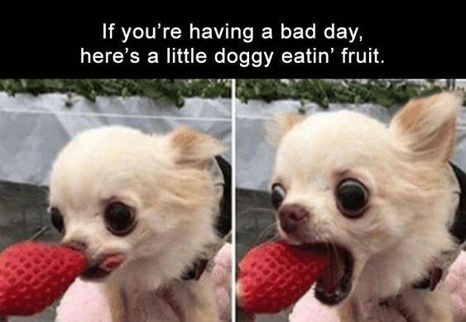
isaac stier robson
event-centric narratives
17 jan 2020 18 / 62

Slide 19
background cloze

Slide 20
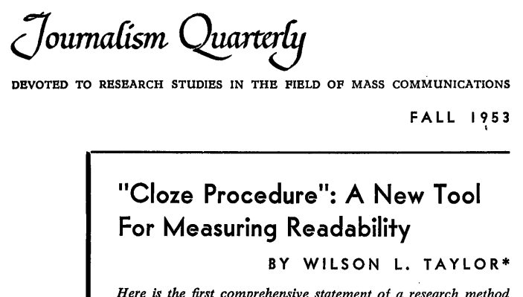
cloze taylor (1953)
isaac stier robson
event-centric narratives
17 jan 2020 20 / 62

Slide 21
cloze examples + context dependence
simple:
“chickens cackle and ______ quack”
context-dependent:
“i heard a ______ bark”
“for the first time, i heard a ______ bark”
…what if prior context involved an island where seals live?
cloze quite influential today, à la bert, devlin et al. (2018) https://arxiv.org/abs/1810.04805
isaac stier robson
event-centric narratives
17 jan 2020 21 / 62

Slide 22
cloze reasoning
quantitative, stochastic metric of “readability” (…or understanding)
contrasted with sentence-completion (blanks here are random)
don’t have to blank good words out
merely enough words to be representative
authors claim this makes blanks contextually interrelated
also influenced:
story cloze task https://arxiv.org/abs/1604.01696
ernie (phrase & entity clozes) https://arxiv.org/abs/1904.09223
isaac stier robson
event-centric narratives
17 jan 2020 22 / 62

Slide 23
background stanford parser

Slide 24
stanford parser rationale
in english, grammar is an implicit context
because grammar in english is (mostly) deterministic, we can make parsers
the stanford parser:
captures part of speech (pos) tagging (e.g. verb)
grammatical relations (e.g. direct object of verb)
dependency parsing (dependency on verbs)
parsers were (and somewhat still are) important pre-processing
isaac stier robson
event-centric narratives
17 jan 2020 24 / 62

Slide 25
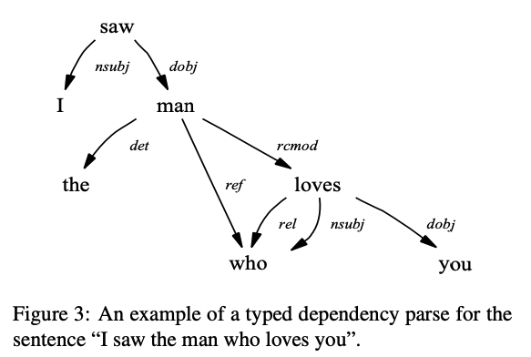
stanford parser example
isaac stier robson
event-centric narratives
17 jan 2020 25 / 62

Slide 26
stanford parser for chambers + jurafsky (2008)
the stanford parser is used during both
event induction and
temporal ordering
chambers et al. (2007) used pos-tagging from stanford parser
(as input features for the first of two classifiers) https://www.aclweb.org/anthology/P07-2044/
chambers + jurafsky (2008) also used dependency parsing to identify events
isaac stier robson
event-centric narratives
17 jan 2020 26 / 62

Slide 27
background scripts

Slide 28
scripts schank + abelson (1977)
two fundamental problems stand out:
how do people map natural language strings into a representation of their meaning?
how do people encode thoughts into natural language strings?
- scripts, plans, goals, and understanding schank + abelson
isaac stier robson
event-centric narratives
17 jan 2020 28 / 62

Slide 29
scripts cd theory
emphasize conceptual dependency (cd) theory
for both psychology and artificial intelligence
axiom:
two sentences identical in meaning have only one representation
(regardless of words used)
corollary:
implicit information in the sentence is explicit in the representation
isaac stier robson
event-centric narratives
17 jan 2020 29 / 62

Slide 30
scripts conceptualizations
cd theory pushes representation as conceptualizations
by forcing structure of events, “could focus on content”
conceptualizations (active form):
(actor, action, object, direction, [instrument*])
conceptualizations (stative form):
(object, state, [value*])
* optional argument
isaac stier robson
event-centric narratives
17 jan 2020 30 / 62

Slide 31
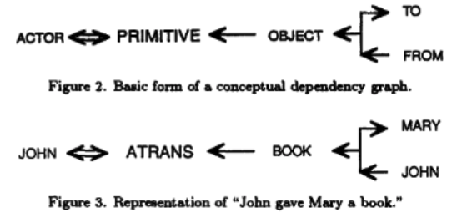
scripts graphical example
lytinen (1992)
https://www.sciencedirect.com/science/article/pii/0898122192901366
isaac stier robson
event-centric narratives
17 jan 2020 31 / 62

Slide 32
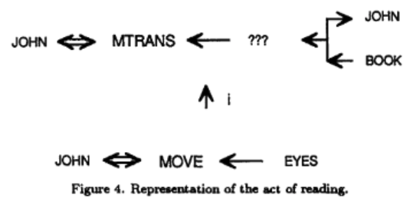
scripts script learning
lytinen (1992)
https://www.sciencedirect.com/science/article/pii/0898122192901366
isaac stier robson
event-centric narratives
17 jan 2020 32 / 62

Slide 33
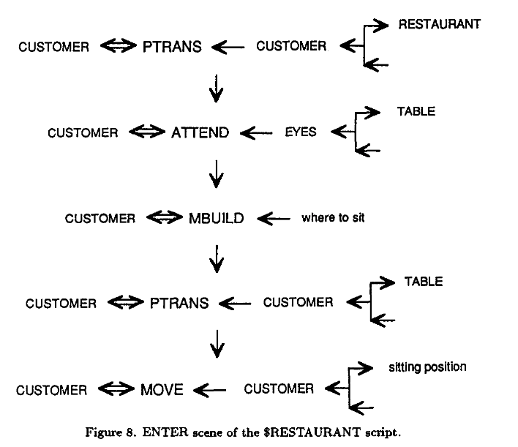
scripts building up
conceptualizations could then be built (by hand) into scenes
these scripts are then a loose “narrative chain”
as given some input conditions and roles (e.g. waiter, customer), an algorithm should be able to predict what happens
lytinen (1992)
isaac stier robson
event-centric narratives
17 jan 2020 33 / 62

Slide 34
scripts example
eunice [finally]: what's the matter, honey? are you lost?
blanche [with faintly hysterical humor]: they told me to take a street-car named desire, and then transfer to one called cemeteries and ride six blocks and get off at – elysian fields!
eunice: that's where you are now
blanche: at elysian fields?
– a streetcar named desire
isaac stier robson
event-centric narratives
17 jan 2020 34 / 62

Slide 35
scripts example
eunice [finally]: what's the matter, honey? are you lost?
blanche [with faintly hysterical humor]: they told me to take a street-car named desire, and then transfer to one called cemeteries and ride six blocks and get off at – elysian fields!
eunice: that's where you are now
blanche: at elysian fields?
– a streetcar named desire
eunice [finally]: what's the matter, honey? are you lost?
blanche [with faintly hysterical humor]: they told me to take a street-car named desire, and then transfer to one called cemeteries and ride six blocks and get off at – elysian fields!
eunice: that's where you are now
blanche: at elysian fields?
– a streetcar named desire
inside of a larger script
fairly script-like
…could scripts capture the meaning?
isaac stier robson
event-centric narratives
17 jan 2020 35 / 62

Slide 36
chambers + jurafsky (2008)

Slide 37
chambers and jurafsky (2008) big picture
connect events into chains
from the stanford parser output, define an event e:
$e$ = (verb, entity, dependency)
e.g. (barked, dog, subject)
thus some document, $d$, can be converted to an unordered set of events:
$d$= {$e1$, $e2$, $e3$, … $en$}
isaac stier robson
event-centric narratives
17 jan 2020 37 / 62

Slide 38
chambers and jurafsky (2008) big picture
to order events into chains, just need to recognize which events are before others
then sota temporal model used pairs of events in a classifier chambers et al. (2007) https://www.aclweb.org/anthology/P07-2044/
so the before indicator variable is merely $b$:
$b$($ei$, $ej$) = $\left\{\begin{aligned}1 if ei before ej \\ 0 else \end{aligned}\right.$
isaac stier robson
event-centric narratives
17 jan 2020 38 / 62

Slide 39
chambers and jurafsky (2008) big picture
this could yield a sorted document $dsorted$:
$dsorted$ = {$e_{(1)}$,${ e}_{(2)}$, $e_{(3)}$, … $e_{(n)}$}
that can be grouped into discrete chains $c$:
$c$ = {$e_{(i)}$,${ e}_{(j)}$, ${ e}_{(k)}$…} for $i<j<k<$… *
yielding $dec$ = {$c_{1}$,${ c}_{2}$,$c_{3}$, … $c_{m}$}
* this implies $b$($ei$, $ej$) = $b$($ej$, $ek$) = … = 1
isaac stier robson
event-centric narratives
17 jan 2020 39 / 62

Slide 40
chambers and jurafsky (2008) houston, we have a
note that $dec$ seems remarkably similar to scenes in scripts
unlike scripts, $dec$ can be automatically created in an unsupervised fashion (presuming parsers exist)
this could be quite useful for nlu!
but… there is a problem
quadratic scaling of event pairs = wayyy too much memory and compute
isaac stier robson
event-centric narratives
17 jan 2020 40 / 62

Slide 41
chambers and jurafsky (2008) narrative coherence
solution: assume narrative coherence
any narrative has implicit restrictions on
coreference usage
discourse structure, and
attention centering from grosz et al (1995) https://www.aclweb.org/anthology/J95-2003/
in effect, the authors propose limiting events to the protagonist as:
unlikely to remove central events
may also enhance narrative learning
isaac stier robson
event-centric narratives
17 jan 2020 41 / 62

Slide 42
chambers and jurafsky (2008) influence: centering
centering is a framework for local attention* & coherence
two main ideas:
in a narrative, certain entities are more central than others
this property constrains subsequent referent expressions
(e.g. pronoun usage, sentence structure)
applies to a local segment inside a larger “discourse”
presumes that each “discourse” has intention that governs coherence (structure)
* not the modern attention mechanism
isaac stier robson
event-centric narratives
17 jan 2020 42 / 62

Slide 43
chambers and jurafsky (2008) influence: centering
define a center of an utterance:
“[refers] to those entities… [that] link that utterance to other utterances in the discourse segment”
each utterance $ui$ in discourse segment $ds$ has:
one backward-looking center $cb$($ui$, $ds$) = $uj$
multiple forward-looking centers $cf$($ui$, $ds$) = {$uk$}
a discourse can then transition:
center continuation
center retaining
center shifting
isaac stier robson
event-centric narratives
17 jan 2020 43 / 62

Slide 44
chambers and jurafsky (2008) centering in application
in c + j (2008) events removed if they don’t involve the protagonist
should narrative coherence (like centering) hold, not unreasonable pruning
to identify the protagonist:
apply coreference resolution
set the most common entity = protagonist
opennlp’s coreference resolution is the pipeline authors employ
…is this a fair assumption?
isaac stier robson
event-centric narratives
17 jan 2020 44 / 62

Slide 45
chambers and jurafsky (2008) centering: potential limits
i am only seven, but i understand that it is this fact, more than any other, that makes my family different: we don’t go to school.
dad worries the government will force us to go, but it can’t because it doesn’t know we exist. four of my parents’ seven children don’t have birth certificates, we have no medical records because we were born at home and have never seen a doctor or nurse...
when i am nine, i will be issued a delayed certificate of birth, but at this moment, according to the state of idaho and the federal government, i do not exist.
– educated
tara westover
protagonist?
i ∊ four ⊂ seven ⊂ family
isaac stier robson
event-centric narratives
17 jan 2020 45 / 62

Slide 46
chambers and jurafsky (2008) narrative events
conditioned on entity = protagonist, we can simply events to narrative events
$e$ = (verb, dependency)
e.g. (barked, subject)
once we’ve extracted narrative events, we need some metric to compare them
authors propose simply looking at co-occurrence across documents
(as events that co-occur likely have relationships, see distributional semantic)
http://en.wikipedia.org/wiki/Distributional_semantics
isaac stier robson
event-centric narratives
17 jan 2020 46 / 62

Slide 47
chambers and jurafsky (2008) narrative events
rather than use a more complicated metric like tf-idf, settle for raw co-occurrence*
given a corpus of documents ⅆ = {$d$_{1,} $d$_{2,} $d$_{3,}… $dp$}
define the likelihood of seeing events $e$_{i} and $e$_{j} together**:
$p$($e$_{i}, $e$_{j}) = $\frac{\text{count}\text{ⅆ}\text{(}ei\text{,}ej\text{)}}{\sum_{ek,el}{\text{count}\text{ⅆ}\text{(}ek\text{,}el\text{)}}}$
$\text{count}\text{ⅆ}\text{(}ei\text{,} e\text{j}\text{)}$ = $\left| \left\{d∊\text{ⅆ} \right| ei∊d and ej∊d\} \right|$
*discounting rare events
narrative coherence assumption?
isaac stier robson
event-centric narratives
17 jan 2020 47 / 62

Slide 48
chambers and jurafsky (2008) narrative events
we can then create a pairwise mutual information score, pmi:
$pmi$($e$_{i}, $e$_{j}) = log $\frac{p\text{(}e\text{i}\text{, }e\text{j}\text{)}}{p\text{(}e\text{i}\text{)}p\text{(}e\text{j}\text{)}}$ $≥$ 0
an affinity score that can assist in finding similar events
e.g. predicting next event given a set of events
$next$({$e$₁, $e$₂, … $e$_{n}}) = $\underset{x}{argmax}$ $\sum_{i=1}^{n}{pmi(ei, x)}$
(note: requires $x$ present in training data)
isaac stier robson
event-centric narratives
17 jan 2020 48 / 62

Slide 49
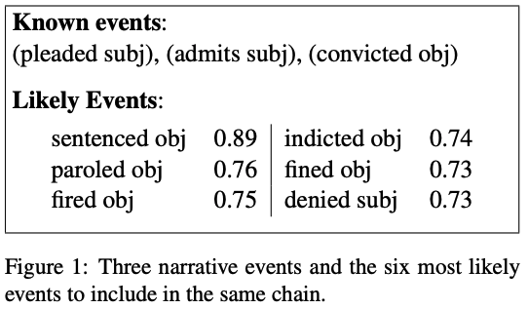
chambers and jurafsky (2008) narrative cloze test
at this point, there is an opportunity to evaluate narrative coherence
idea: predict missing/next event, aka narrative cloze
isaac stier robson
event-centric narratives
17 jan 2020 49 / 62

Slide 50
chambers and jurafsky (2008) narrative cloze test
want to evaluate use model thus far as the “[narrative] typed-dependency” model
issue: number of possible events, $n=\left|\{ei\}\right|$, is
$\left|verbs\right|$ x $\left|dependencies\right|$
implies without reducing to protagonists, a “full model*” would require
$\left|verbs\right|$² x $\left|dependencies\right|$² time and space
as authors show, even $\left|verbs\right|$² is computationally intractable
*if such a model would make sense
isaac stier robson
event-centric narratives
17 jan 2020 50 / 62

Slide 51
chambers and jurafsky (2008) narrative cloze test
so how can they evaluate it?
best they can do is evaluate “protagonist” against “verb-only” baseline (ignoring typed dependencies)
verb-only avg = 1826
verb + protagonist
avg = 1160
rank → lower = better
isaac stier robson
event-centric narratives
17 jan 2020 51 / 62

Slide 52
chambers and jurafsky (2008) narrative cloze test
once they’ve shown that narrative coherence holds, they include the full typed-dependency model
not directly comparable to baseline as now guess list is larger by factor of $\left|dependencies\right|$
they emphasize the parallelism between protagonist and typed-dependency models
an important thing left now is ordering chains of events
isaac stier robson
event-centric narratives
17 jan 2020 52 / 62

Slide 53
chambers and jurafsky (2008) ordering
authors use a previously-published temporal classifier (chambers et al. (2007))
input into first stage is stanford parser results; output from second stage is simply before or other
to transition to arbitrary events (w/o pos-tagging, etc), the authors process the entire gigawords corpus in one batch
they then can compare generic event A to generic event B
reason: $b$($ei$, $ej$) as described is not symmetric*
so both $b$($ei$, $ej$) and $b$($ej$, $ei$) can be one!
*timebank has seven classes
isaac stier robson
event-centric narratives
17 jan 2020 53 / 62

Slide 54
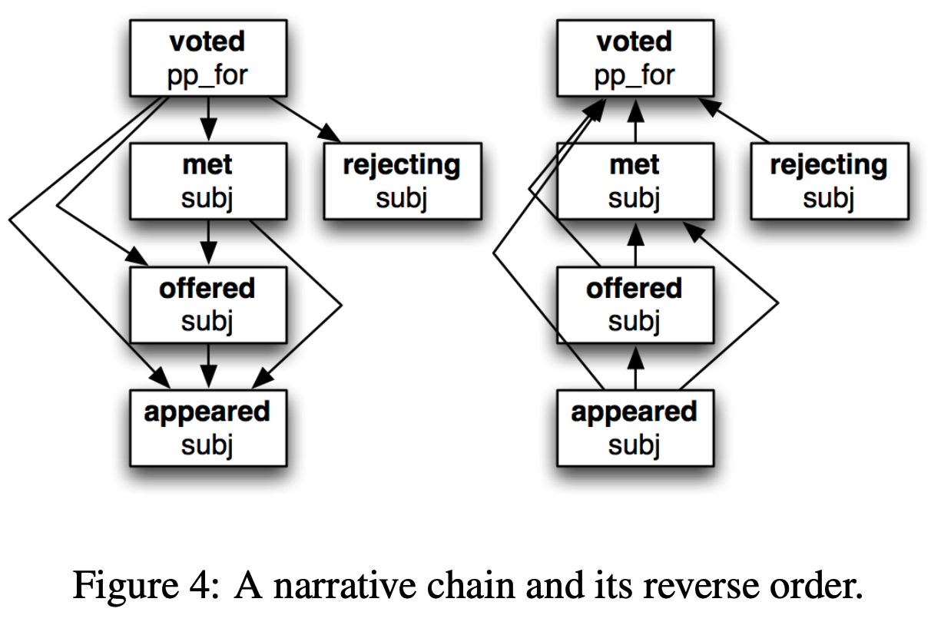
chambers and jurafsky (2008) ordering - example
isaac stier robson
event-centric narratives
17 jan 2020 54 / 62

Slide 55
chambers and jurafsky (2008) ordering – model creation
ordering model created as:
start by training temporal model on timebank
compute $b$($ei$, $ej$) and$b$($ej$, $ei$) for all $ei$, $ej$ pairs in gigaword corpus ⅆ
sum $\hat{b}$($ei$, $ej$) = $\sum_{\text{ⅆ}}{b\text{(}ei\text{, }ej\text{)}}$
create $d\left(ei\text{, }ej\right)=\left|\hat{b}\text{(}ei\text{, }ej\text{)}−\hat{b}\text{(}ej\text{, }ei\text{)}\right|$
define coherence score as a function of input xβy (x before y)
isaac stier robson
event-centric narratives
17 jan 2020 55 / 62

Slide 56
chambers and jurafsky (2008) ordering – model formula
coherence($dsorted$ = {$e_{(1)}$,${ e}_{(2)}$, … $e_{(n)}$}):
$$\sum_{x,y}{\left\{\begin{aligned}\begin{aligned} log d\left(x,y\right) if x\text{β}y \text{and} \text{b}\text{(}x\text{,}y\text{)}\text{ > }\text{b}\text{(}y,x) \\ − log d\left(x,y\right) if x\text{β}y \text{and} \text{b}\text{(}x\text{,}y\text{) }\text{<} \text{b}\text{(}y,x)\end{aligned} \\ −log d\left(x,y\right) if !x\text{β}y \text{and} !y\text{β}x and d\left(x,y\right)>0 \\ 0 otherwise \end{aligned}\right.}$$
smooth magnitude of
classification confidence
negative penalizes disagreement of input order with gigaword order
isaac stier robson
event-centric narratives
17 jan 2020 56 / 62

Slide 57
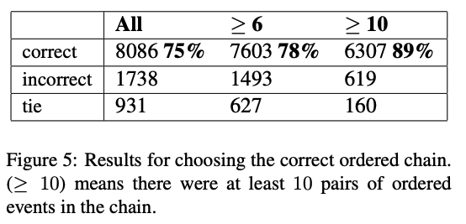
chambers and jurafsky (2008) ordering – results
the authors then evaluate:
hand-created (correct) orders vs.
randomly generated orders
isaac stier robson
event-centric narratives
17 jan 2020 57 / 62

Slide 58
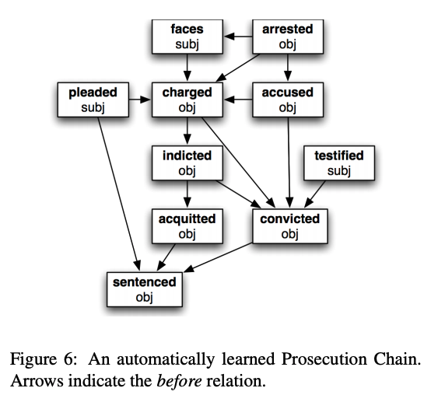
chambers and jurafsky (2008) ordering – results
authors end by suggesting (not evaluating) method for discrete chain parsing
they propose using the pre-established pmi scores with agglomerative clusterings
no evaluation, but the cherry-picked example does look nice
isaac stier robson
event-centric narratives
17 jan 2020 58 / 62

Slide 59
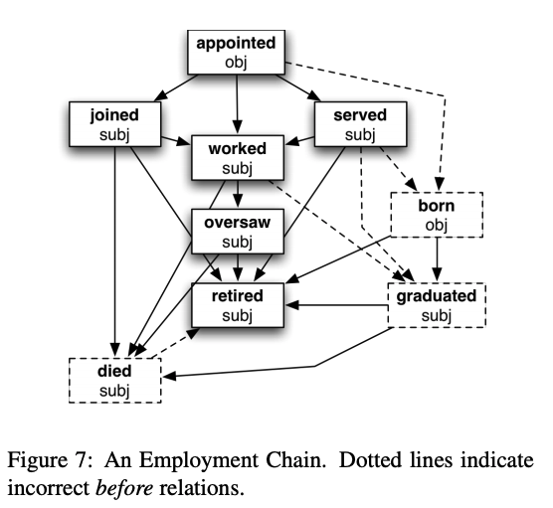
chambers and jurafsky (2008) ordering – results
a second (bad) example is provided
authors mention that timebank dataset is biased, so many life events etc. aren’t easy to predict
not an infrequent problem for pipelined nlp solutions
isaac stier robson
event-centric narratives
17 jan 2020 59 / 62

Slide 60
chambers and jurafsky (2008) pipeline
order coherence accuracy
stanford parser
part of speech
temporal classifier
events + typed dependencies
gigaword
narrative
event chains
agglomerative clustering
narrative events
opennlp coreference
protagonist
pairwise mutual info
narrative cloze rank
coreferences
isaac stier robson
event-centric narratives
17 jan 2020 60 / 62

Slide 61
isaac stier robson
event-centric narratives
17 jan 2020 61 / 62

Slide 62
</end>
isaac stier robson
event-centric narratives
17 jan 2020 62 / 62

